Slide 2
0
1
2
3
4
5
6
7
8
9
0
0
1
2
3
4
5
6
7
8
9
0
0
1
2
3
4
5
6
7
8
9
0
0
1
2
3
4
5
6
7
8
9
0
0
1
2
3
4
5
6
7
8
9
0
0
1
2
3
4
5
6
7
8
9
0
0
1
2
3
4
5
6
7
8
9
0
0
1
2
3
4
5
6
7
8
9
0
0
1
2
3
4
5
6
7
8
9
0
0
1
2
34
5
6
7
8
9
0
0
1
2
3
4
5
6
7
8
9
0
0
1
2
3
4
5
6
7
8
9
0
Notes:
That is longer than the total existence of human history
global-estimates-of-informal-care.pdf

Slide 3

0
1
2
3
4
5
6
7
8
9
0
0
1
2
3
4
5
6
7
8
9
0
0
1
2
3
4
5
6
7
8
9 0
0
1
2
3
4
5
6
7
8
9
0
0
1
2
3
4
5
6
7
8
9
0
0
1
2
3
4
5
6
7
8
9
0
0
1
2
3
4
5
6
7
8
9
0
0
1
2
3
4
5
6
7
8
9
0
0
1
2
3
4
5
6
7
8
9
0
600,000,000,000
0
1
2
3
4
5
6
7
8
9
0
0
1
2
3
4
5
6
7
8
9
0
0
1
2
3
4
5
6
7
8
9
0
USD
Worth of unpaid caretaking done by family caregiver in USA. American Association of Retired Persons
Notes:
That is longer than the total existence of human history
global-estimates-of-informal-care.pdf

Slide 4


0
1
2
3
4
5
6
7
8
9
0
0
1
2
3
4
5
6
7
8
9
0
0
1
2
3
4
5
6
7
8
9
0
0
1
2
3
4
5
6
7
8
9
0
0
1
2
3
4
5
6
7
8
9
0
0
1
2
3
4
5
6
7
8
9
0
0
1
2
3
4
5
6
7
8
9
01
2
0
1
2
3
4
5
6
7
8
9
0
0
1
2
3
4
5
6
7
8
9 0
0
1
2
3
4
5
6
7
8
9
0
0
1
2
3
4
5
6
7
8
9
0
82,000,000,000
Hours
No. of unpaid care hours provided to people with dementia living at home Alzheimer’s Disease International, 2015
Notes:
That is longer than the total existence of human history
global-estimates-of-informal-care.pdf

Slide 5

0
1
2
3
4
5
6
7
8
9
0
0
1
2
3
4
5
6
7
8
9
0
0
1
2
3
4
5
6
7
8
9 0
0
1
2
3
4
5
6
7
8
9
0
1,500,000
0
1
2
3
4
5
6
7
8
9
0
0
1
2
3
4
5
6
7
8
9
0
0
1
2
3
4
5
6
7
8
9
0
Caretakers
In United Kingdom who provided 50 +hours of unpaid care a week Census 2021, Office of National Statistics, UK
Notes:
That is longer than the total existence of human history
global-estimates-of-informal-care.pdf

Slide 6



Slide 7



40%
Of family caregiver are at risk of depression
40%

Slide 8


'I worry if he’s taken care of’: The tears and fears of millennial caregivers to siblings with special needs
By Charmaine Jacob | 31 Jan 2025
CNA meets two young individuals figuring out how to live life while ensuring their siblings with special needs have a
"WHY COULDN'T I HAVE A REGULAR OLDER BROTHER?“
It wasn’t always smooth sailing for Ms Chandramogan, especially when she was a teenager trying to carve out her own path. “I was always rambling on about why this was happening to me and why I couldn't have a regular older brother,” she said, adding that she was even bullied by others who thought she was lying about her brother to get attention. While going through puberty, her brother had more aggressive meltdowns, and would leave his sister with bite marks on her arms. Today the siblings are closer than ever. “Bala starts every day as a reboot. Even when we’re frustrated at each other, we’ll be back to square one the next day like nothing happened. I’m thankful that I don’t have to deal with grudges, like other siblings might have to,” said Ms Chandramogan. Her brother's friendly nature, bright smile and 1.81m stature have also earned him the moniker of “calm giant” in the family. Vaduvkarasi Chandramogan often feels mentally drained from taking care of Balamurugan Chandramogan, but seeing a smile on her brother's face makes it all worth it . (Photo: CNA/Raydza Rahman) Ms Chandramogan still worries whether her brother will ever be independent in his daily living, and she hopes she'll be able to take care of him for the rest of his life. To get some respite from the stresses of caregiving, she turns to good food as a "pick-me-up" as well as running and going to the gym. “Taking care of Bala means taking care of myself, because I need to be healthy and strong enough to be able to care for him,” she said. Financial concerns are also at play, ever since she made the switch from full-time to part-time work to better manage the caregiving needs of her mother and brother. But the load isn't entirely on her shoulders. Her husband of two years has made an effort to learn more about her brother and to accompany them for medical appointments. “He moved in and started helping out in the house, and understood the levels of caregiving he can afford to do," she said. "So if I’m giving my 80 per cent, he’ll give his 20 per cent and we try to interchange depending on our schedules.” As for what the couple want for themselves, that painful memory from Ms Chandramogan's dating past still lingers - though she revealed she would consider having a child in five years. “If I’m going to have a child, how would I go through the pregnancy while dealing with Bala? Will he understand the pregnancy? Will he be calm when the baby is here?” she asked. “These are the fears that I have.“
CAREGIVING OBLIGATIONS
Not all siblings would take on a caregiving role as willingly as Ms Chandramogan has, said Ms Amber Lim, clinical psychologist at Reconnect Psychology & Family Therapy. She said that while families with a close relationship do it out of love, many millennials might feel forced into it instead. “While most of our parents will ask us to focus on education and jobs, these siblings need to balance their ageing parents, the care needs of siblings with special needs, and worry if their siblings are being well taken care of.” “Those that feel obligated can often feel a sense of loneliness and helplessness, compared to someone who is well-supported,” Ms Lim said. Ms Shireen Yeo, founder of sibling support group Sibs Unite, said it was important for caregivers to share their struggles with other members of the household if possible, as well as people outside the family. “For some of us, it’s the only safe space where we can talk about experiences that other people might not understand,” she said. “There is an internal desire to meet people that can resonate with their struggles.” Sisters Rebecca and Rachel Boey singing together at the piano on Jan 27, 2025. (Photo: CNA/Raydza Rahman)
A CLOSE BUT CHALLENGING RELATIONSHIP
For 29-year-old caregiver Rachel Boey, a source of support,

Slide 9
CNA meets two young individuals figuring out how to live life while ensuring their siblings with special needs have a
"WHY COULDN'T I HAVE A REGULAR OLDER BROTHER?“
It wasn’t always smooth sailing for Ms Chandramogan, especially when she was a teenager trying to carve out her own path. “I was always rambling on about why this was happening to me and why I couldn't have a regular older brother,” she said, adding that she was even bullied by others who thought she was lying about her brother to get attention. While going through puberty, her brother had more aggressive meltdowns, and would leave his sister with bite marks on her arms. Today the siblings are closer than ever. “Bala starts every day as a reboot. Even when we’re frustrated at each other, we’ll be back to square one the next day like nothing happened. I’m thankful that I don’t have to deal with grudges, like other siblings might have to,” said Ms Chandramogan. Her brother's friendly nature, bright smile and 1.81m stature have also earned him the moniker of “calm giant” in the family. Vaduvkarasi Chandramogan often feels mentally drained from taking care of Balamurugan Chandramogan, but seeing a smile on her brother's face makes it all worth it . (Photo: CNA/Raydza Rahman) Ms Chandramogan still worries whether her brother will ever be independent in his daily living, and she hopes she'll be able to take care of him for the rest of his life. To get some respite from the stresses of caregiving, she turns to good food as a "pick-me-up" as well as running and going to the gym. “Taking care of Bala means taking care of myself, because I need to be healthy and strong enough to be able to care for him,” she said. Financial concerns are also at play, ever since she made the switch from full-time to part-time work to better manage the caregiving needs of her mother and brother. But the load isn't entirely on her shoulders. Her husband of two years has made an effort to learn more about her brother and to accompany them for medical appointments. “He moved in and started helping out in the house, and understood the levels of caregiving he can afford to do," she said. "So if I’m giving my 80 per cent, he’ll give his 20 per cent and we try to interchange depending on our schedules.” As for what the couple want for themselves, that painful memory from Ms Chandramogan's dating past still lingers - though she revealed she would consider having a child in five years. “If I’m going to have a child, how would I go through the pregnancy while dealing with Bala? Will he understand the pregnancy? Will he be calm when the baby is here?” she asked. “These are the fears that I have.“
CAREGIVING OBLIGATIONS
Not all siblings would take on a caregiving role as willingly as Ms Chandramogan has, said Ms Amber Lim, clinical psychologist at Reconnect Psychology & Family Therapy. She said that while families with a close relationship do it out of love, many millennials might feel forced into it instead. “While most of our parents will ask us to focus on education and jobs, these siblings need to balance their ageing parents, the care needs of siblings with special needs, and worry if their siblings are being well taken care of.” “Those that feel obligated can often feel a sense of loneliness and helplessness, compared to someone who is well-supported,” Ms Lim said. Ms Shireen Yeo, founder of sibling support group Sibs Unite, said it was important for caregivers to share their struggles with other members of the household if possible, as well as people outside the family. “For some of us, it’s the only safe space where we can talk about experiences that other people might not understand,” she said. “There is an internal desire to meet people that can resonate with their struggles.” Sisters Rebecca and Rachel Boey singing together at the piano on Jan 27, 2025. (Photo: CNA/Raydza Rahman)
A CLOSE BUT CHALLENGING RELATIONSHIP
For 29-year-old caregiver Rachel Boey, a source of support,
'I worry if he’s taken care of’: The tears and fears of millennial caregivers to siblings with special needs
By Charmaine Jacob | 31 Jan 2025

Slide 10

I love dad to bits - but being his career has broken me
By Brendon Williams | 5 March 2025
A son who looks after his father for 24-hours a day says he has reached "breaking point" and is calling for more mental health support for those who care for their loved ones. Bernard Mendoza, 82, developed dementia three years ago and has been cared for by his son Danny at home ever since. Danny Mendoza, 54, from Gresford, Wrexham, said he loved his father "to bits" but had been "living like a hermit" and the isolation had left him feeling suicidal. The Welsh government said unpaid carers played a vital role and that it was committed to ensuring support was available. Danny has had depression for 20 years but his condition worsened after he became his father's sole carer. "It's had a huge impact on my mental health," he said. "I've never been so depressed in my life. It got to the point where I was considering suicide as a way out. "It's at that point I knew I wasn't well." Danny, a man in his 50s, with glasses and a grey beard, wearing a denim shirt Danny Mendoza, 54, says the isolation of caring for his father had left him feeling suicidal After speaking to his doctor, Danny was put in touch with social services the next day who arranged for his father to spend six weeks in a care home for a period of respite. He said agreeing to place his father in temporary care left him "ridden with guilt", but "there's only so much you can do before you end up broken, and that's no use to me or my dad". He said more support should have been made available before he reached "breaking point". "I should have reached out earlier, but nevertheless I still feel that there should be something there in place to ensure that family carers don't reach a position where they're at burnout or in a very dark place like myself," he said.
'That is an insult'
For the past few years, Danny has been taking one break a week for four hours while his father visits a day centre. He said the loneliness of being a sole carer made him feel he had "lost contact with the real world". Danny, who was forced to leave his job three years ago, said the system for unpaid carers was "totally broken" and criticised the £328-per-month Carer's Allowance he said he received. "I'm sorry, but that is an insult. I'm a 24/7 carer. Yes, he's my dad and I love him to bits, but I'm his carer and the money should at least reflect minimum wage. You've still got to live. It's not right." BBC/Brendon Williams Gareth Stafford and his mother Gill. Gareth is sat in his electric wheelchair, and is wearing a back-to-front baseball cap. His mother Gill has her arm around him and is smiling at the camera.BBC/Brendon Williams Gill Stafford says unpaid carers can feel "invisible" and ignored Gill Stafford, 76, has been the sole carer for her son Gareth since her husband died 10 years ago. Gareth, 38, has cerebral palsy and cannot walk or talk, but plays boccia – a form of bowls – for Wales. Gill, from Abergele, Conwy, said carers "feel like we're invisible sometimes". "I see people going past, through Gareth's window, and quite a few of them wave to him, which is rather nice," she said. "You just feel like going out and saying 'can you come in?'" Gill said Gareth received some social care which allowed her to get out once a week for six hours. She said a carer also took Gareth to Boccia for half a day a week, but she often goes with them so that "I'm chatting to someone". When carers are on holiday, or not available, she said: "You can go weeks without seeing someone, especially over Christmas."
£10bn in unpaid care
New figures from the charity Carers Wales, based on a survey of 1,217 current or former carers, suggested 38% of unpaid carers in Wales struggled mentally while 60% felt overwhelmed. Of those that sought support from social care services, 57% said services were not available when they needed them. Carers Wales said Census data suggested there were 310,000 unpaid carers in Wales, with the work they do estimated to be worth £10bn if they were paid. Rob Simkins, the charity's head of policy, said the findings "should be ringing alarm bells across Wales," and warned parts of the NHS would "simply not work" without unpaid carers. He said they were responsible for keeping large numbers of people out of hospital, and without them, "everything we've worked for to try and get people out of hospitals into homes, completely falls apart". He added: "This report is the latest in a long line of reports exposing the issues facing unpaid carers in Wales and the failures that have led to this point," he added. "We now need to see urgent action and leadership from the Welsh government to address these issues as a top priority. Anything less is simply not acceptable." The Welsh government said it was committed to "ensuring support continues to be available". It said it had allocated £42million to support unpaid carers since 2022, adding: "We continue to work closely with health boards and local authorities to drive improvements in services for carers, including access to carers needs assessments." The UK government said it was increasing the Carer's Allowance earnings threshold and making extra money available for local authorities.

Slide 11
I love dad to bits - but being his carer has broken me
By Brendon Williams | 5 March 2025
A son who looks after his father for 24-hours a day says he has reached "breaking point" and is calling for more mental health support for those who care for their loved ones. Bernard Mendoza, 82, developed dementia three years ago and has been cared for by his son Danny at home ever since. Danny Mendoza, 54, from Gresford, Wrexham, said he loved his father "to bits" but had been "living like a hermit" and the isolation had left him feeling suicidal. The Welsh government said unpaid carers played a vital role and that it was committed to ensuring support was available. Danny has had depression for 20 years but his condition worsened after he became his father's sole carer. "It's had a huge impact on my mental health," he said. "I've never been so depressed in my life. It got to the point where I was considering suicide as a way out. "It's at that point I knew I wasn't well." Danny, a man in his 50s, with glasses and a grey beard, wearing a denim shirt Danny Mendoza, 54, says the isolation of caring for his father had left him feeling suicidal After speaking to his doctor, Danny was put in touch with social services the next day who arranged for his father to spend six weeks in a care home for a period of respite. He said agreeing to place his father in temporary care left him "ridden with guilt", but "there's only so much you can do before you end up broken, and that's no use to me or my dad". He said more support should have been made available before he reached "breaking point". "I should have reached out earlier, but nevertheless I still feel that there should be something there in place to ensure that family carers don't reach a position where they're at burnout or in a very dark place like myself," he said.
'That is an insult'
For the past few years, Danny has been taking one break a week for four hours while his father visits a day centre. He said the loneliness of being a sole carer made him feel he had "lost contact with the real world". Danny, who was forced to leave his job three years ago, said the system for unpaid carers was "totally broken" and criticised the £328-per-month Carer's Allowance he said he received. "I'm sorry, but that is an insult. I'm a 24/7 carer. Yes, he's my dad and I love him to bits, but I'm his carer and the money should at least reflect minimum wage. You've still got to live. It's not right." BBC/Brendon Williams Gareth Stafford and his mother Gill. Gareth is sat in his electric wheelchair, and is wearing a back-to-front baseball cap. His mother Gill has her arm around him and is smiling at the camera.BBC/Brendon Williams Gill Stafford says unpaid carers can feel "invisible" and ignored Gill Stafford, 76, has been the sole carer for her son Gareth since her husband died 10 years ago. Gareth, 38, has cerebral palsy and cannot walk or talk, but plays boccia – a form of bowls – for Wales. Gill, from Abergele, Conwy, said carers "feel like we're invisible sometimes". "I see people going past, through Gareth's window, and quite a few of them wave to him, which is rather nice," she said. "You just feel like going out and saying 'can you come in?'" Gill said Gareth received some social care which allowed her to get out once a week for six hours. She said a carer also took Gareth to Boccia for half a day a week, but she often goes with them so that "I'm chatting to someone". When carers are on holiday, or not available, she said: "You can go weeks without seeing someone, especially over Christmas."
£10bn in unpaid care
New figures from the charity Carers Wales, based on a survey of 1,217 current or former carers, suggested 38% of unpaid carers in Wales struggled mentally while 60% felt overwhelmed. Of those that sought support from social care services, 57% said services were not available when they needed them. Carers Wales said Census data suggested there were 310,000 unpaid carers in Wales, with the work they do estimated to be worth £10bn if they were paid. Rob Simkins, the charity's head of policy, said the findings "should be ringing alarm bells across Wales," and warned parts of the NHS would "simply not work" without unpaid carers. He said they were responsible for keeping large numbers of people out of hospital, and without them, "everything we've worked for to try and get people out of hospitals into homes, completely falls apart". He added: "This report is the latest in a long line of reports exposing the issues facing unpaid carers in Wales and the failures that have led to this point," he added. "We now need to see urgent action and leadership from the Welsh government to address these issues as a top priority. Anything less is simply not acceptable." The Welsh government said it was committed to "ensuring support continues to be available". It said it had allocated £42million to support unpaid carers since 2022, adding: "We continue to work closely with health boards and local authorities to drive improvements in services for carers, including access to carers needs assessments." The UK government said it was increasing the Carer's Allowance earnings threshold and making extra money available for local authorities.

Slide 12
A son who looks after his father for 24-hours a day says he has reached "breaking point" and is calling for more mental health support for those who care for their loved ones. Bernard Mendoza, 82, developed dementia three years ago and has been cared for by his son Danny at home ever since. Danny Mendoza, 54, from Gresford, Wrexham, said he loved his father "to bits" but had been "living like a hermit" and the isolation had left him feeling suicidal. The Welsh government said unpaid carers played a vital role and that it was committed to ensuring support was available. Danny has had depression for 20 years but his condition worsened after he became his father's sole carer. "It's had a huge impact on my mental health," he said. "I've never been so depressed in my life. It got to the point where I was considering suicide as a way out. "It's at that point I knew I wasn't well." Danny, a man in his 50s, with glasses and a grey beard, wearing a denim shirt Danny Mendoza, 54, says the isolation of caring for his father had left him feeling suicidal After speaking to his doctor, Danny was put in touch with social services the next day who arranged for his father to spend six weeks in a care home for a period of respite. He said agreeing to place his father in temporary care left him "ridden with guilt", but "there's only so much you can do before you end up broken, and that's no use to me or my dad". He said more support should have been made available before he reached "breaking point". "I should have reached out earlier, but nevertheless I still feel that there should be something there in place to ensure that family carers don't reach a position where they're at burnout or in a very dark place like myself," he said.
'That is an insult'
For the past few years, Danny has been taking one break a week for four hours while his father visits a day centre. He said the loneliness of being a sole carer made him feel he had "lost contact with the real world". Danny, who was forced to leave his job three years ago, said the system for unpaid carers was "totally broken" and criticised the £328-per-month Carer's Allowance he said he received. "I'm sorry, but that is an insult. I'm a 24/7 carer. Yes, he's my dad and I love him to bits, but I'm his carer and the money should at least reflect minimum wage. You've still got to live. It's not right." BBC/Brendon Williams Gareth Stafford and his mother Gill. Gareth is sat in his electric wheelchair, and is wearing a back-to-front baseball cap. His mother Gill has her arm around him and is smiling at the camera.BBC/Brendon Williams Gill Stafford says unpaid carers can feel "invisible" and ignored Gill Stafford, 76, has been the sole carer for her son Gareth since her husband died 10 years ago. Gareth, 38, has cerebral palsy and cannot walk or talk, but plays boccia – a form of bowls – for Wales. Gill, from Abergele, Conwy, said carers "feel like we're invisible sometimes". "I see people going past, through Gareth's window, and quite a few of them wave to him, which is rather nice," she said. "You just feel like going out and saying 'can you come in?'" Gill said Gareth received some social care which allowed her to get out once a week for six hours. She said a carer also took Gareth to Boccia for half a day a week, but she often goes with them so that "I'm chatting to someone". When carers are on holiday, or not available, she said: "You can go weeks without seeing someone, especially over Christmas."
£10bn in unpaid care
New figures from the charity Carers Wales, based on a survey of 1,217 current or former carers, suggested 38% of unpaid carers in Wales struggled mentally while 60% felt overwhelmed. Of those that sought support from social care services, 57% said services were not available when they needed them. Carers Wales said Census data suggested there were 310,000 unpaid carers in Wales, with the work they do estimated to be worth £10bn if they were paid. Rob Simkins, the charity's head of policy, said the findings "should be ringing alarm bells across Wales," and warned parts of the NHS would "simply not work" without unpaid carers. He said they were responsible for keeping large numbers of people out of hospital, and without them, "everything we've worked for to try and get people out of hospitals into homes, completely falls apart". He added: "This report is the latest in a long line of reports exposing the issues facing unpaid carers in Wales and the failures that have led to this point," he added. "We now need to see urgent action and leadership from the Welsh government to address these issues as a top priority. Anything less is simply not acceptable." The Welsh government said it was committed to "ensuring support continues to be available". It said it had allocated £42million to support unpaid carers since 2022, adding: "We continue to work closely with health boards and local authorities to drive improvements in services for carers, including access to carers needs assessments." The UK government said it was increasing the Carer's Allowance earnings threshold and making extra money available for local authorities.
I love dad to bits - but being his carer has broken me
By Brendon Williams | 5 March 2025

Slide 13
A son who looks after his father for 24-hours a day says he has reached "breaking point" and is calling for more mental health support for those who care for their loved ones. Bernard Mendoza, 82, developed dementia three years ago and has been cared for by his son Danny at home ever since. Danny Mendoza, 54, from Gresford, Wrexham, said he loved his father "to bits" but had been "living like a hermit" and the isolation had left him feeling suicidal. The Welsh government said unpaid carers played a vital role and that it was committed to ensuring support was available. Danny has had depression for 20 years but his condition worsened after he became his father's sole carer. "It's had a huge impact on my mental health," he said. "I've never been so depressed in my life. It got to the point where I was considering suicide as a way out. "It's at that point I knew I wasn't well." Danny, a man in his 50s, with glasses and a grey beard, wearing a denim shirt Danny Mendoza, 54, says the isolation of caring for his father had left him feeling suicidal After speaking to his doctor, Danny was put in touch with social services the next day who arranged for his father to spend six weeks in a care home for a period of respite. He said agreeing to place his father in temporary care left him "ridden with guilt", but "there's only so much you can do before you end up broken, and that's no use to me or my dad". He said more support should have been made available before he reached "breaking point". "I should have reached out earlier, but nevertheless I still feel that there should be something there in place to ensure that family carers don't reach a position where they're at burnout or in a very dark place like myself," he said.
'That is an insult'
For the past few years, Danny has been taking one break a week for four hours while his father visits a day centre. He said the loneliness of being a sole carer made him feel he had "lost contact with the real world". Danny, who was forced to leave his job three years ago, said the system for unpaid carers was "totally broken" and criticised the £328-per-month Carer's Allowance he said he received. "I'm sorry, but that is an insult. I'm a 24/7 carer. Yes, he's my dad and I love him to bits, but I'm his carer and the money should at least reflect minimum wage. You've still got to live. It's not right." BBC/Brendon Williams Gareth Stafford and his mother Gill. Gareth is sat in his electric wheelchair, and is wearing a back-to-front baseball cap. His mother Gill has her arm around him and is smiling at the camera.BBC/Brendon Williams Gill Stafford says unpaid carers can feel "invisible" and ignored Gill Stafford, 76, has been the sole carer for her son Gareth since her husband died 10 years ago. Gareth, 38, has cerebral palsy and cannot walk or talk, but plays boccia – a form of bowls – for Wales. Gill, from Abergele, Conwy, said carers "feel like we're invisible sometimes". "I see people going past, through Gareth's window, and quite a few of them wave to him, which is rather nice," she said. "You just feel like going out and saying 'can you come in?'" Gill said Gareth received some social care which allowed her to get out once a week for six hours. She said a carer also took Gareth to Boccia for half a day a week, but she often goes with them so that "I'm chatting to someone". When carers are on holiday, or not available, she said: "You can go weeks without seeing someone, especially over Christmas."
£10bn in unpaid care
New figures from the charity Carers Wales, based on a survey of 1,217 current or former carers, suggested 38% of unpaid carers in Wales struggled mentally while 60% felt overwhelmed. Of those that sought support from social care services, 57% said services were not available when they needed them. Carers Wales said Census data suggested there were 310,000 unpaid carers in Wales, with the work they do estimated to be worth £10bn if they were paid. Rob Simkins, the charity's head of policy, said the findings "should be ringing alarm bells across Wales," and warned parts of the NHS would "simply not work" without unpaid carers. He said they were responsible for keeping large numbers of people out of hospital, and without them, "everything we've worked for to try and get people out of hospitals into homes, completely falls apart". He added: "This report is the latest in a long line of reports exposing the issues facing unpaid carers in Wales and the failures that have led to this point," he added. "We now need to see urgent action and leadership from the Welsh government to address these issues as a top priority. Anything less is simply not acceptable." The Welsh government said it was committed to "ensuring support continues to be available". It said it had allocated £42million to support unpaid carers since 2022, adding: "We continue to work closely with health boards and local authorities to drive improvements in services for carers, including access to carers needs assessments." The UK government said it was increasing the Carer's Allowance earnings threshold and making extra money available for local authorities.
I love dad to bits - but being his carer has broken me
By Brendon Williams | 5 March 2025

Slide 14
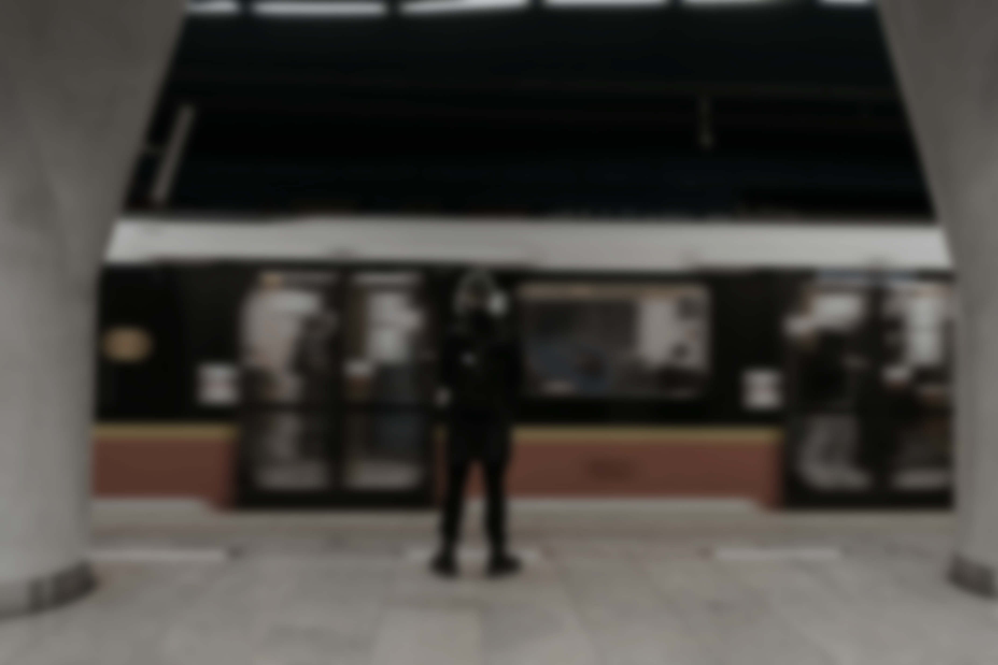

Silent Burden
Lack Community
Fear of judgement
Feeling of Solitude
Busy Schedule
Delayed Support

Slide 15
Silent Burden
Lack Community
Fear of judgement
Feeling of Solitude
Busy Schedule
Delayed Support

Slide 16
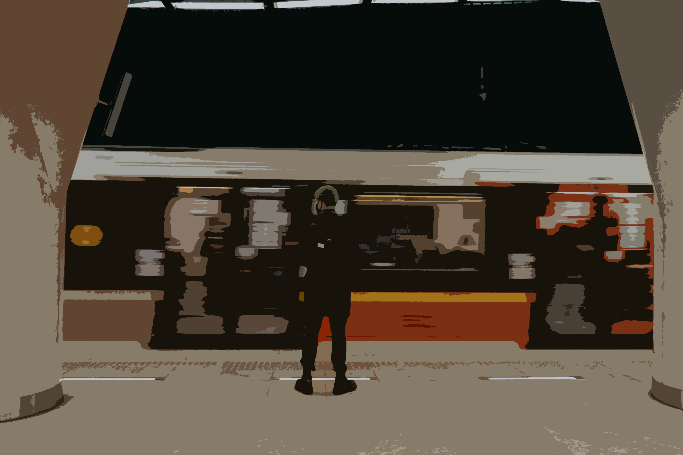
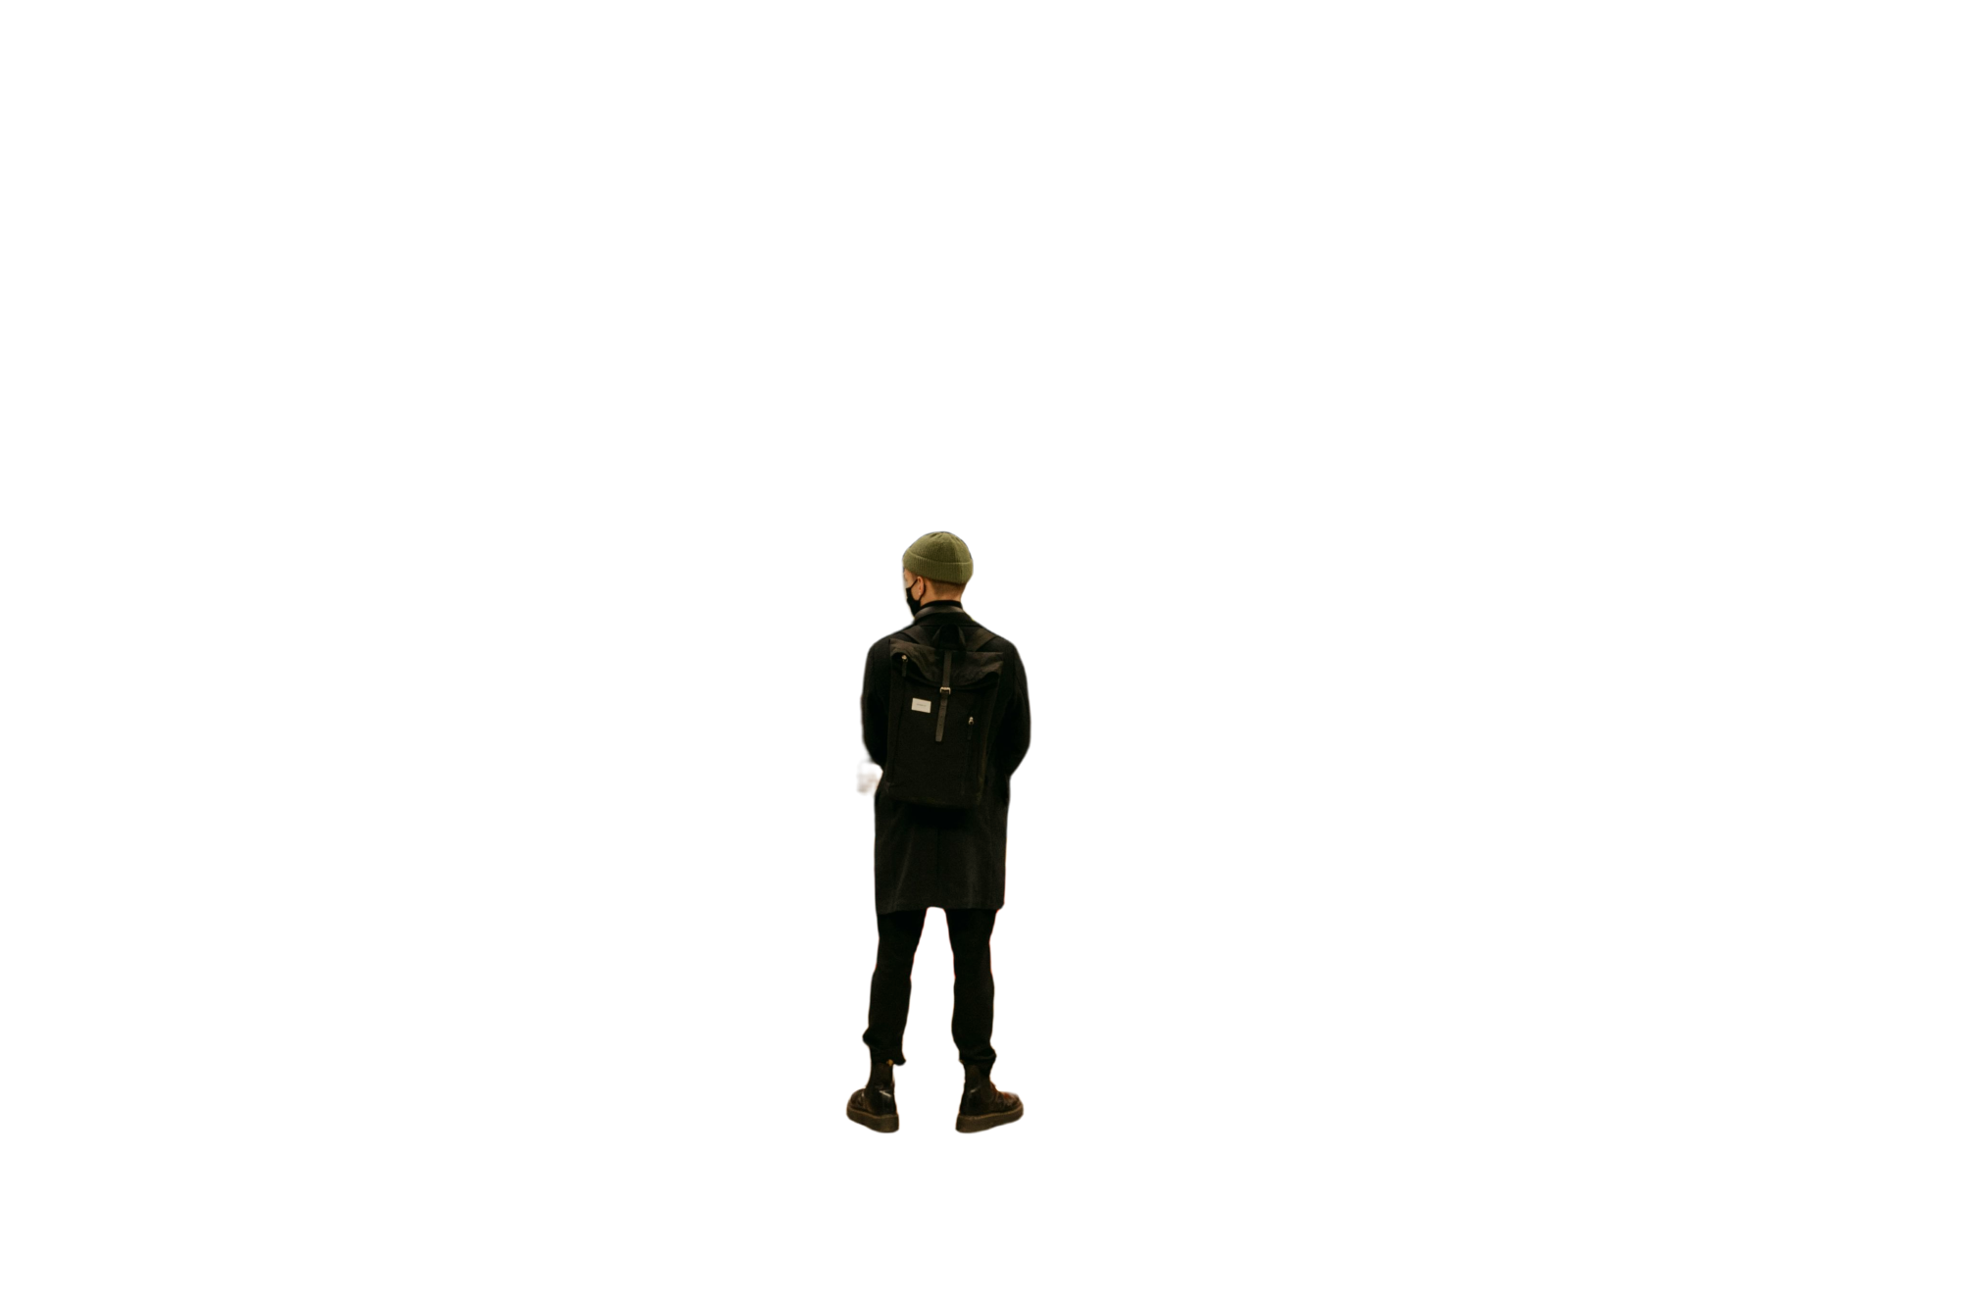
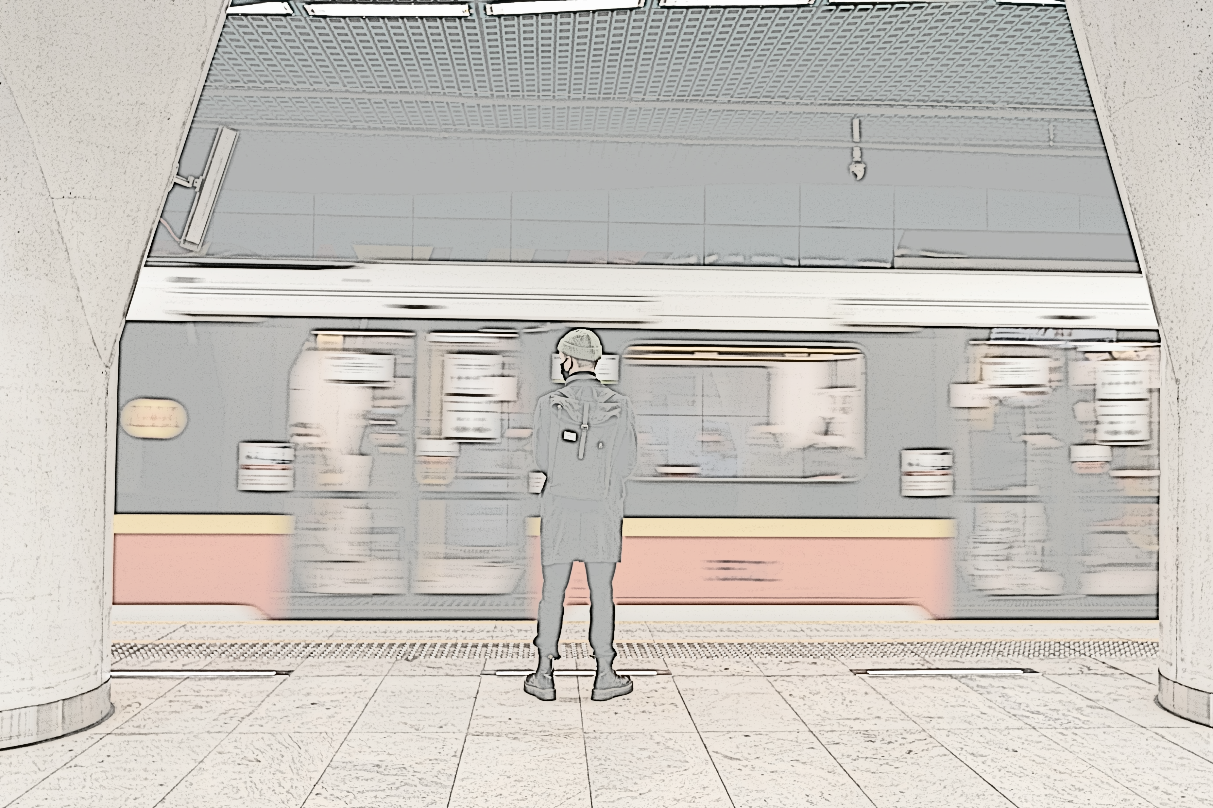


Slide 17



Information is region-limited
Generic information & Solution
Information is region-limited
Lack of real-time
emotional feedback
“Outsiders” does not understand them
Hard to find targeted solutions
Forums
Cyberbully for voicing their emotion
Social Media
Govt. / Experties
Takes time & procedure
→Discourage

Slide 18


PASSIVE
Long response waiting time
Global solution ≠ Local solution
Lack of real-time
emotional feedback
Generic information & Solution
“Outsiders” does not understand them
Hard to find targeted solutions
Backlashed for voicing their emotion
Bureaucratic → Slow, impersonal
Forums
Social Media
Govt. / Experties

Slide 19


PASSIVE
Global solution ≠ Local solution
Long response waiting time
Generic information & Solution
Lack of real-time
emotional feedback
Hard to find targeted solutions
“Outsiders” does not understand them
Bureaucratic → Slow, impersonal
Backlashed for voicing their emotion
Forums
Social Media
Govt. / Experties

Slide 20
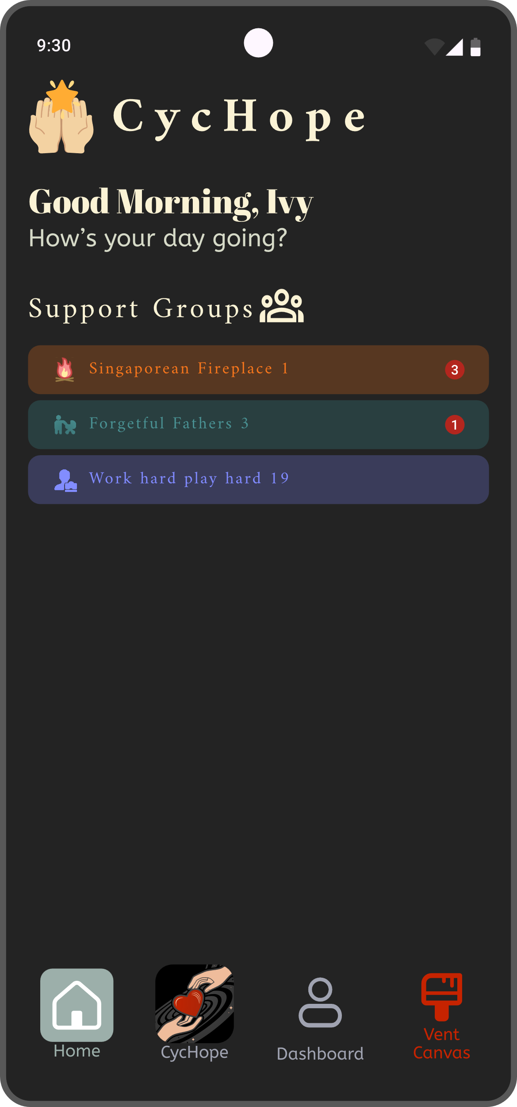
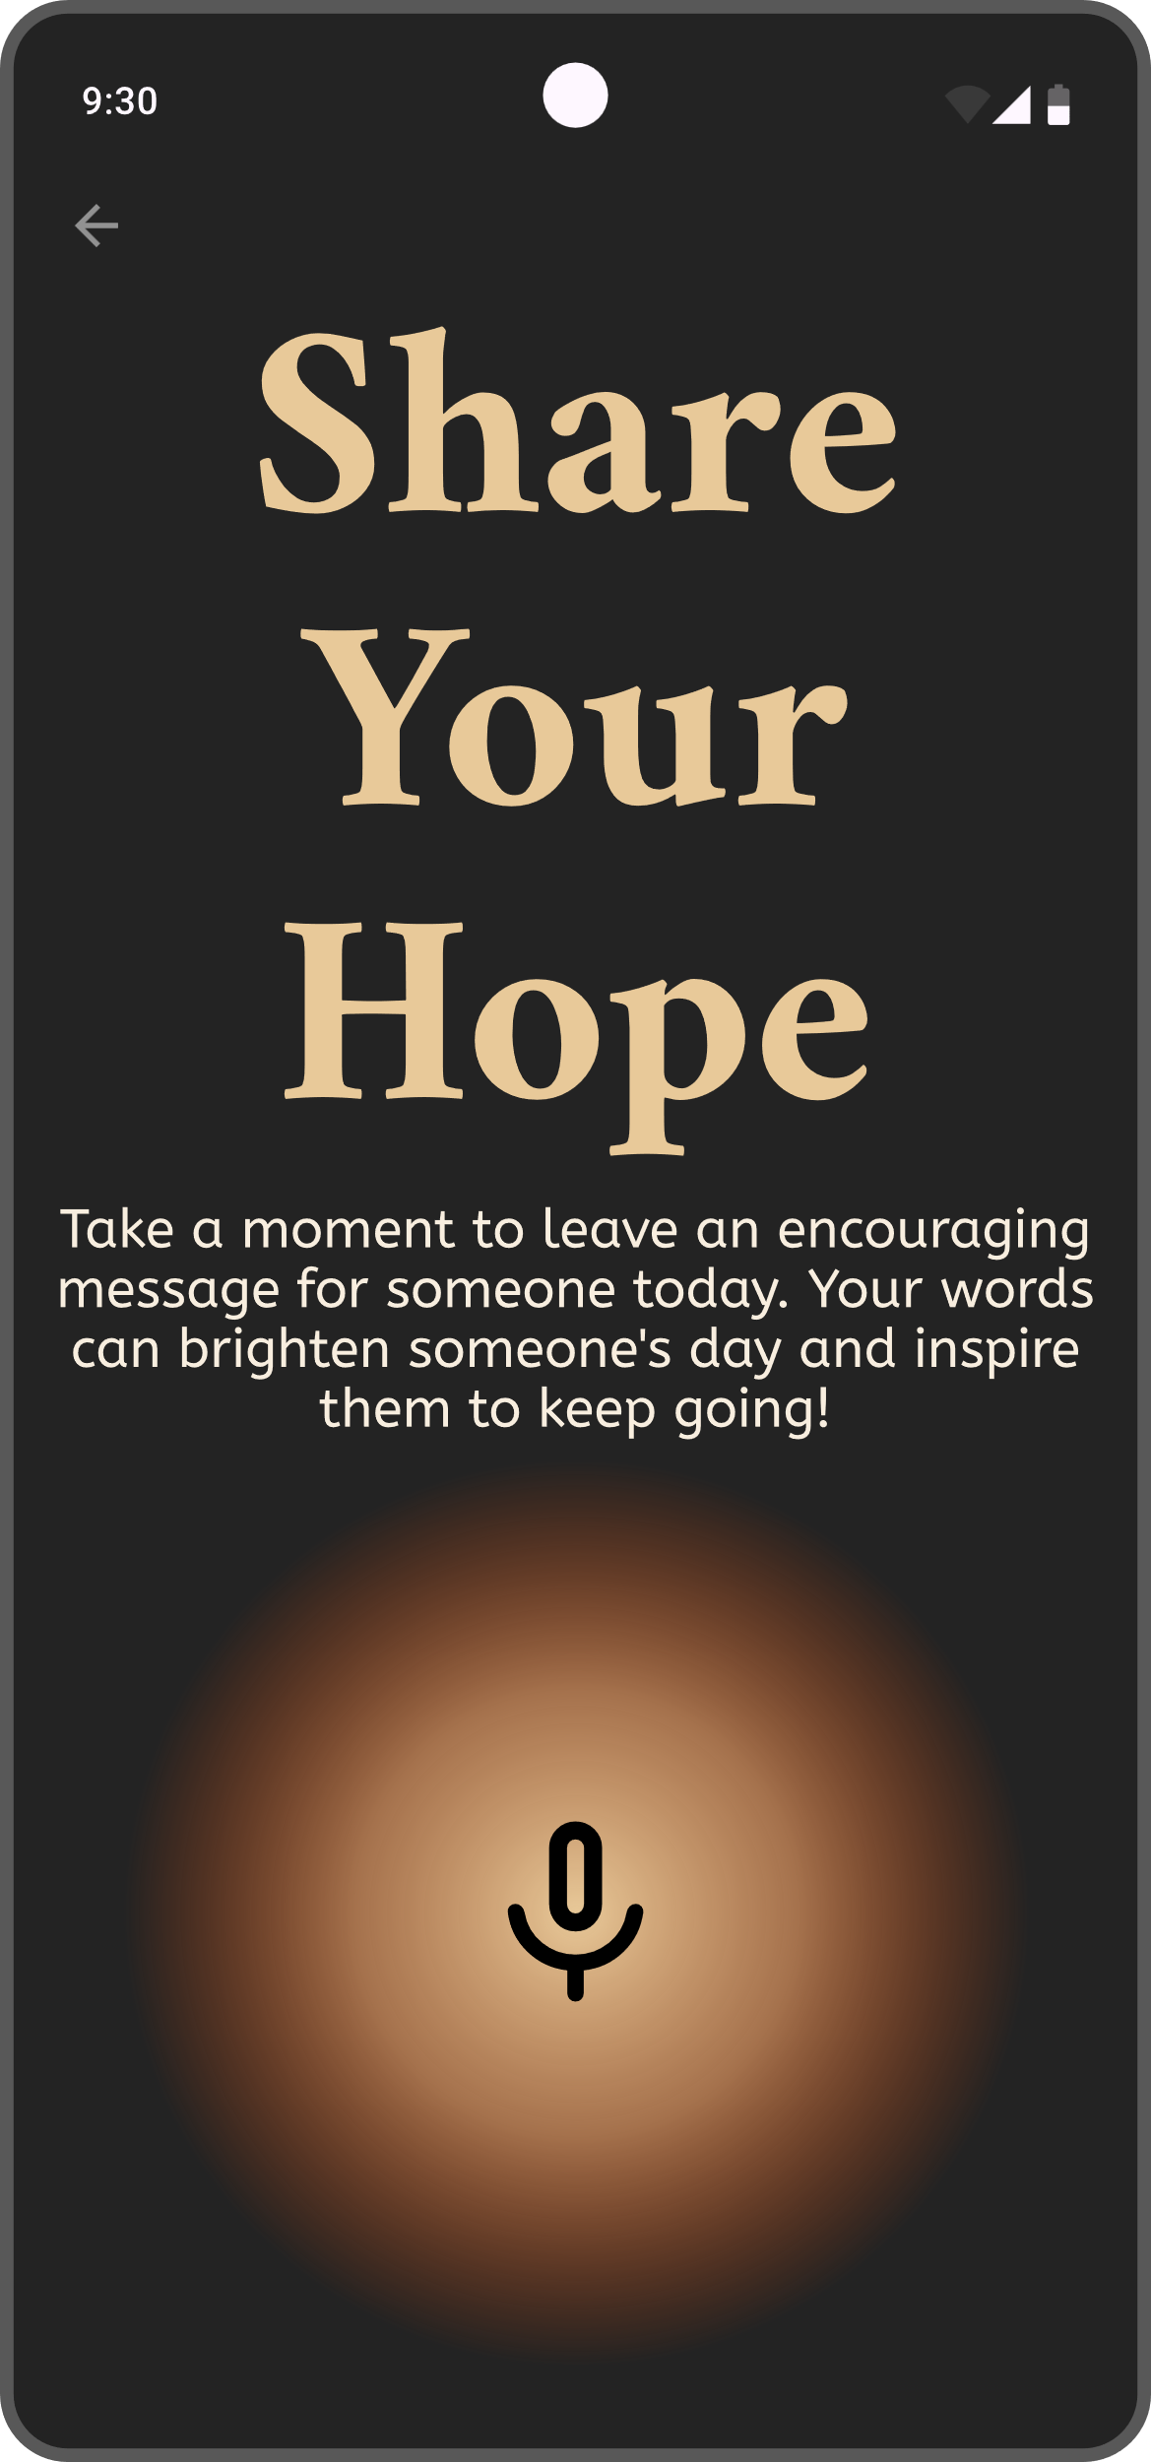

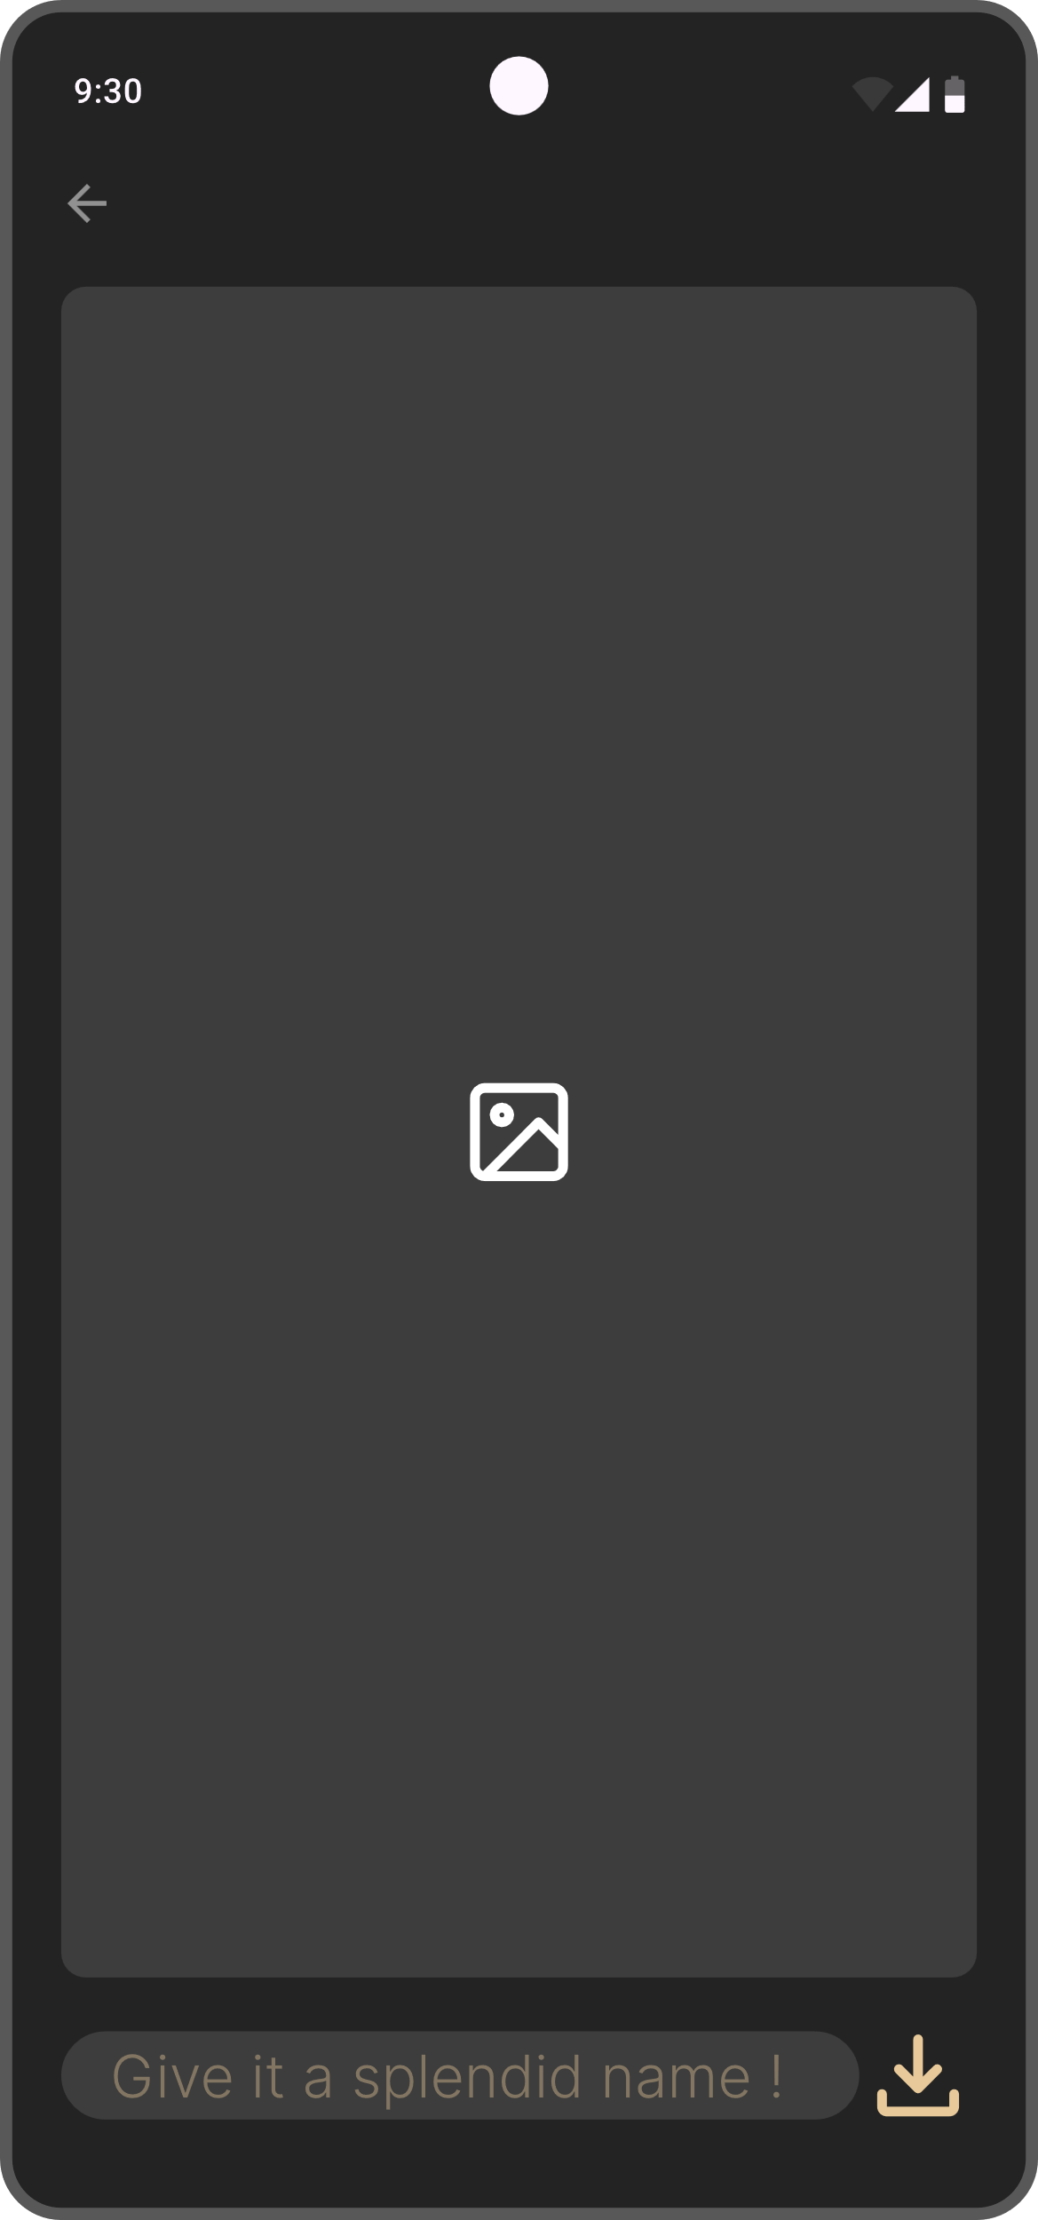
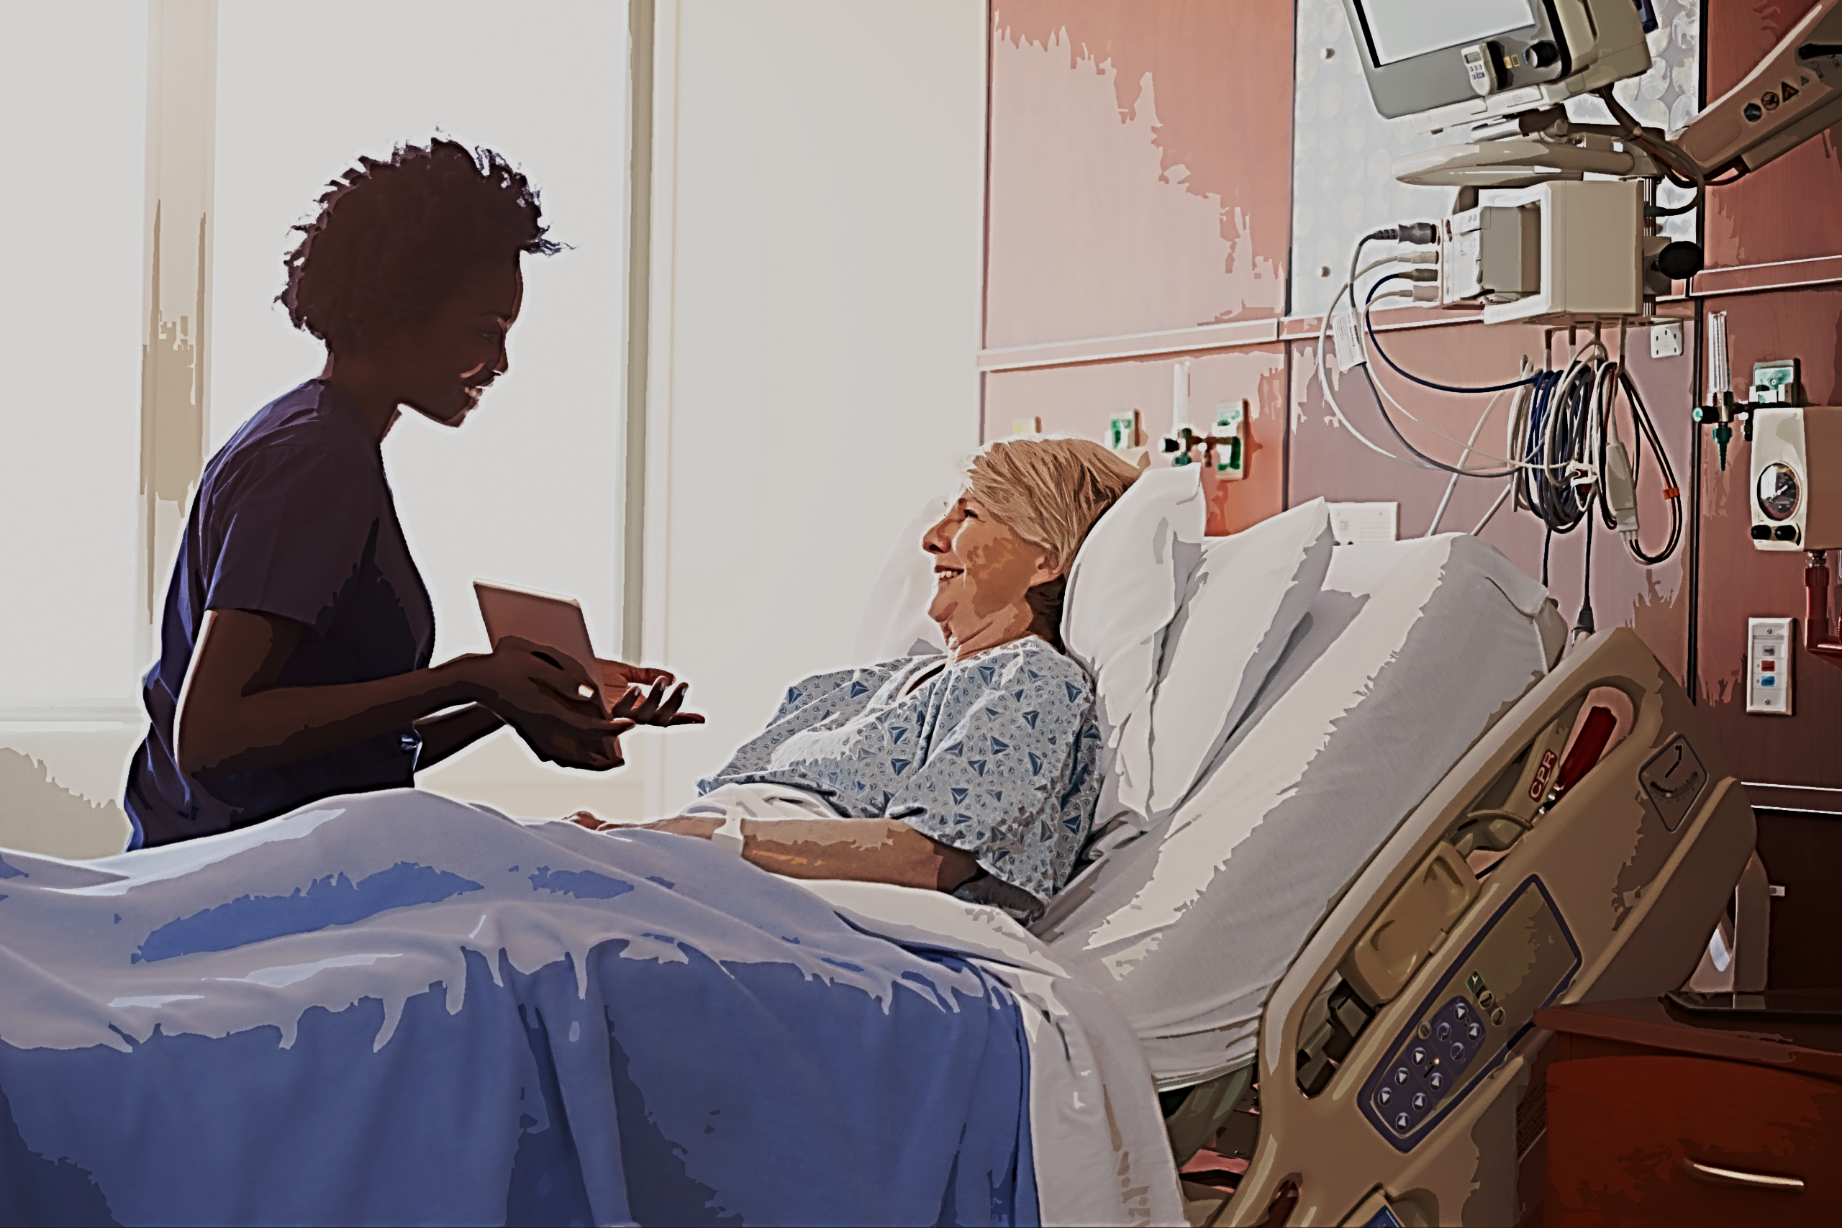
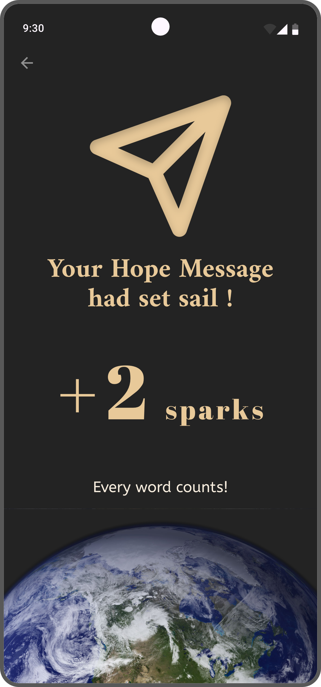
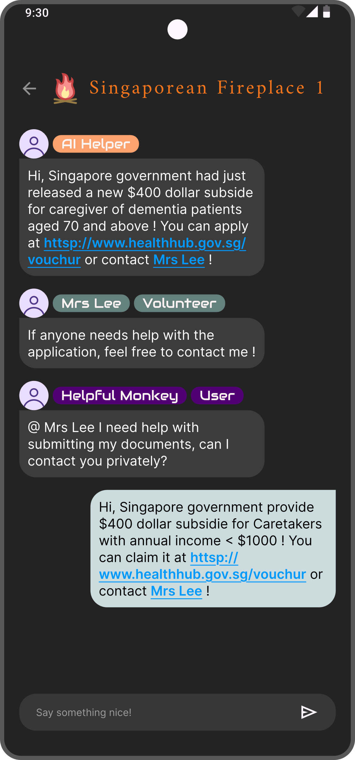
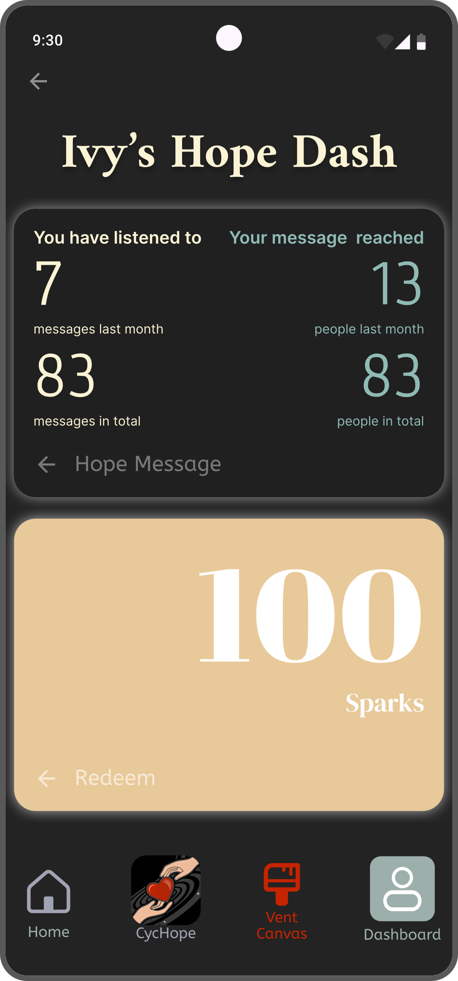
CycHope
Support That finds you

Slide 21
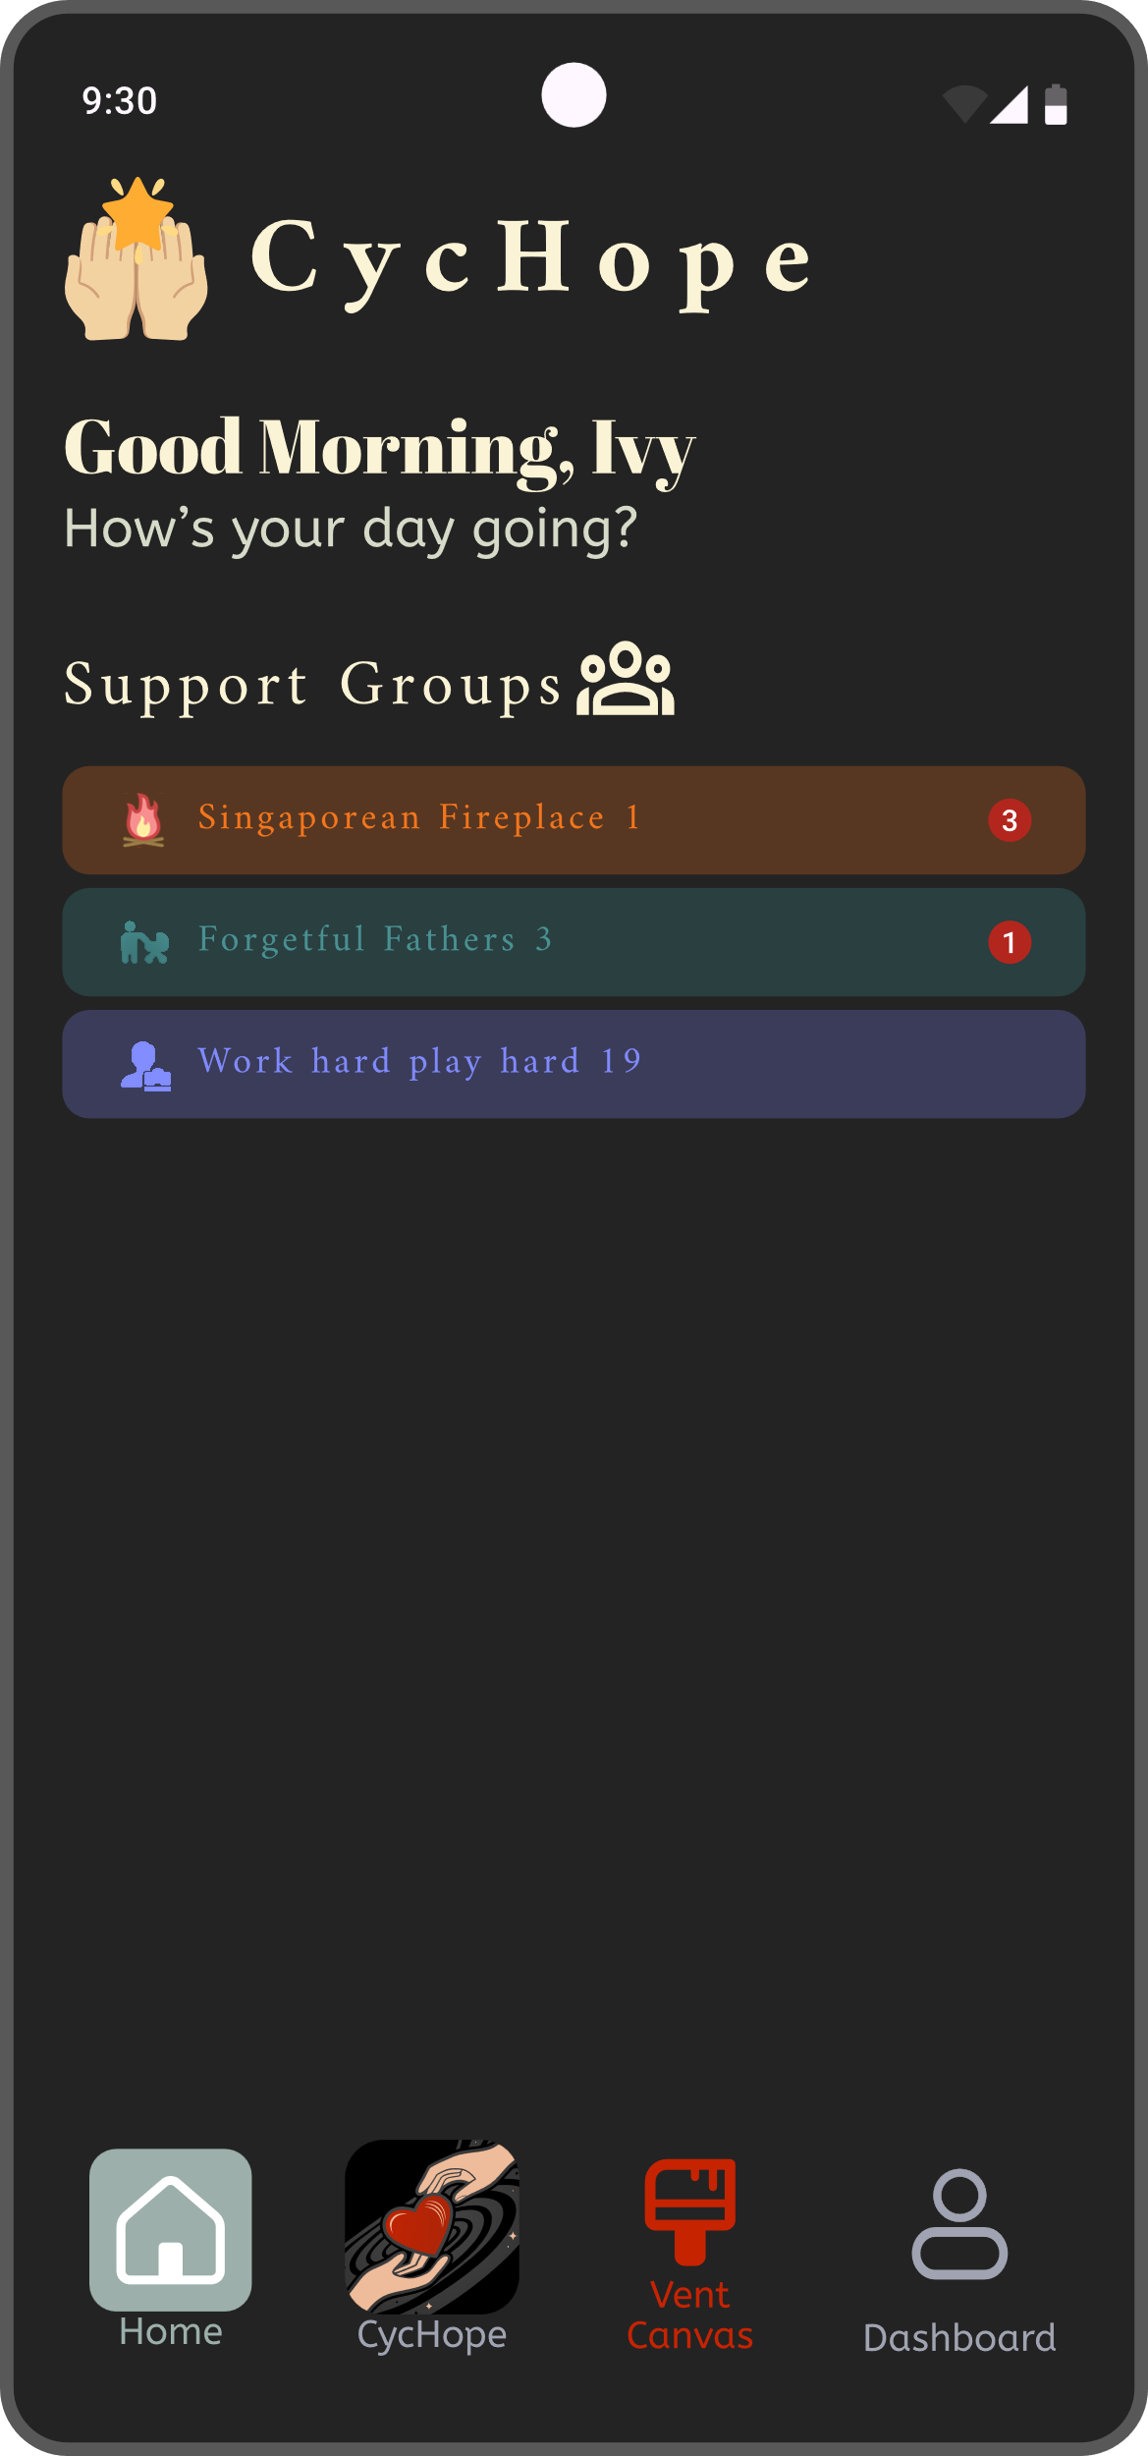

CycHope
Empowered by AI & Community
Smart Support Grouping
Automatic Emotional Support
Bridge Information Gaps

Slide 22


Infer mood from phone usage
*Accuracy based on permission granted
Positive Emotion
Invite user to Share Hope Message
Negative Emotion
Hope Message plays Immersive experience
CycHope
Hope Sharing

Slide 23
Immediate
Receive immediate support at crucial times
Real
Active
CycHope
Hope Sharing

Slide 24
Immediate
Real
From caregiver, to caregiver
Active
CycHope
Hope Sharing

Slide 25
Immediate
Real
Active
Support will find its way to you,
Not the other way around.
CycHope
Hope Sharing

Slide 26
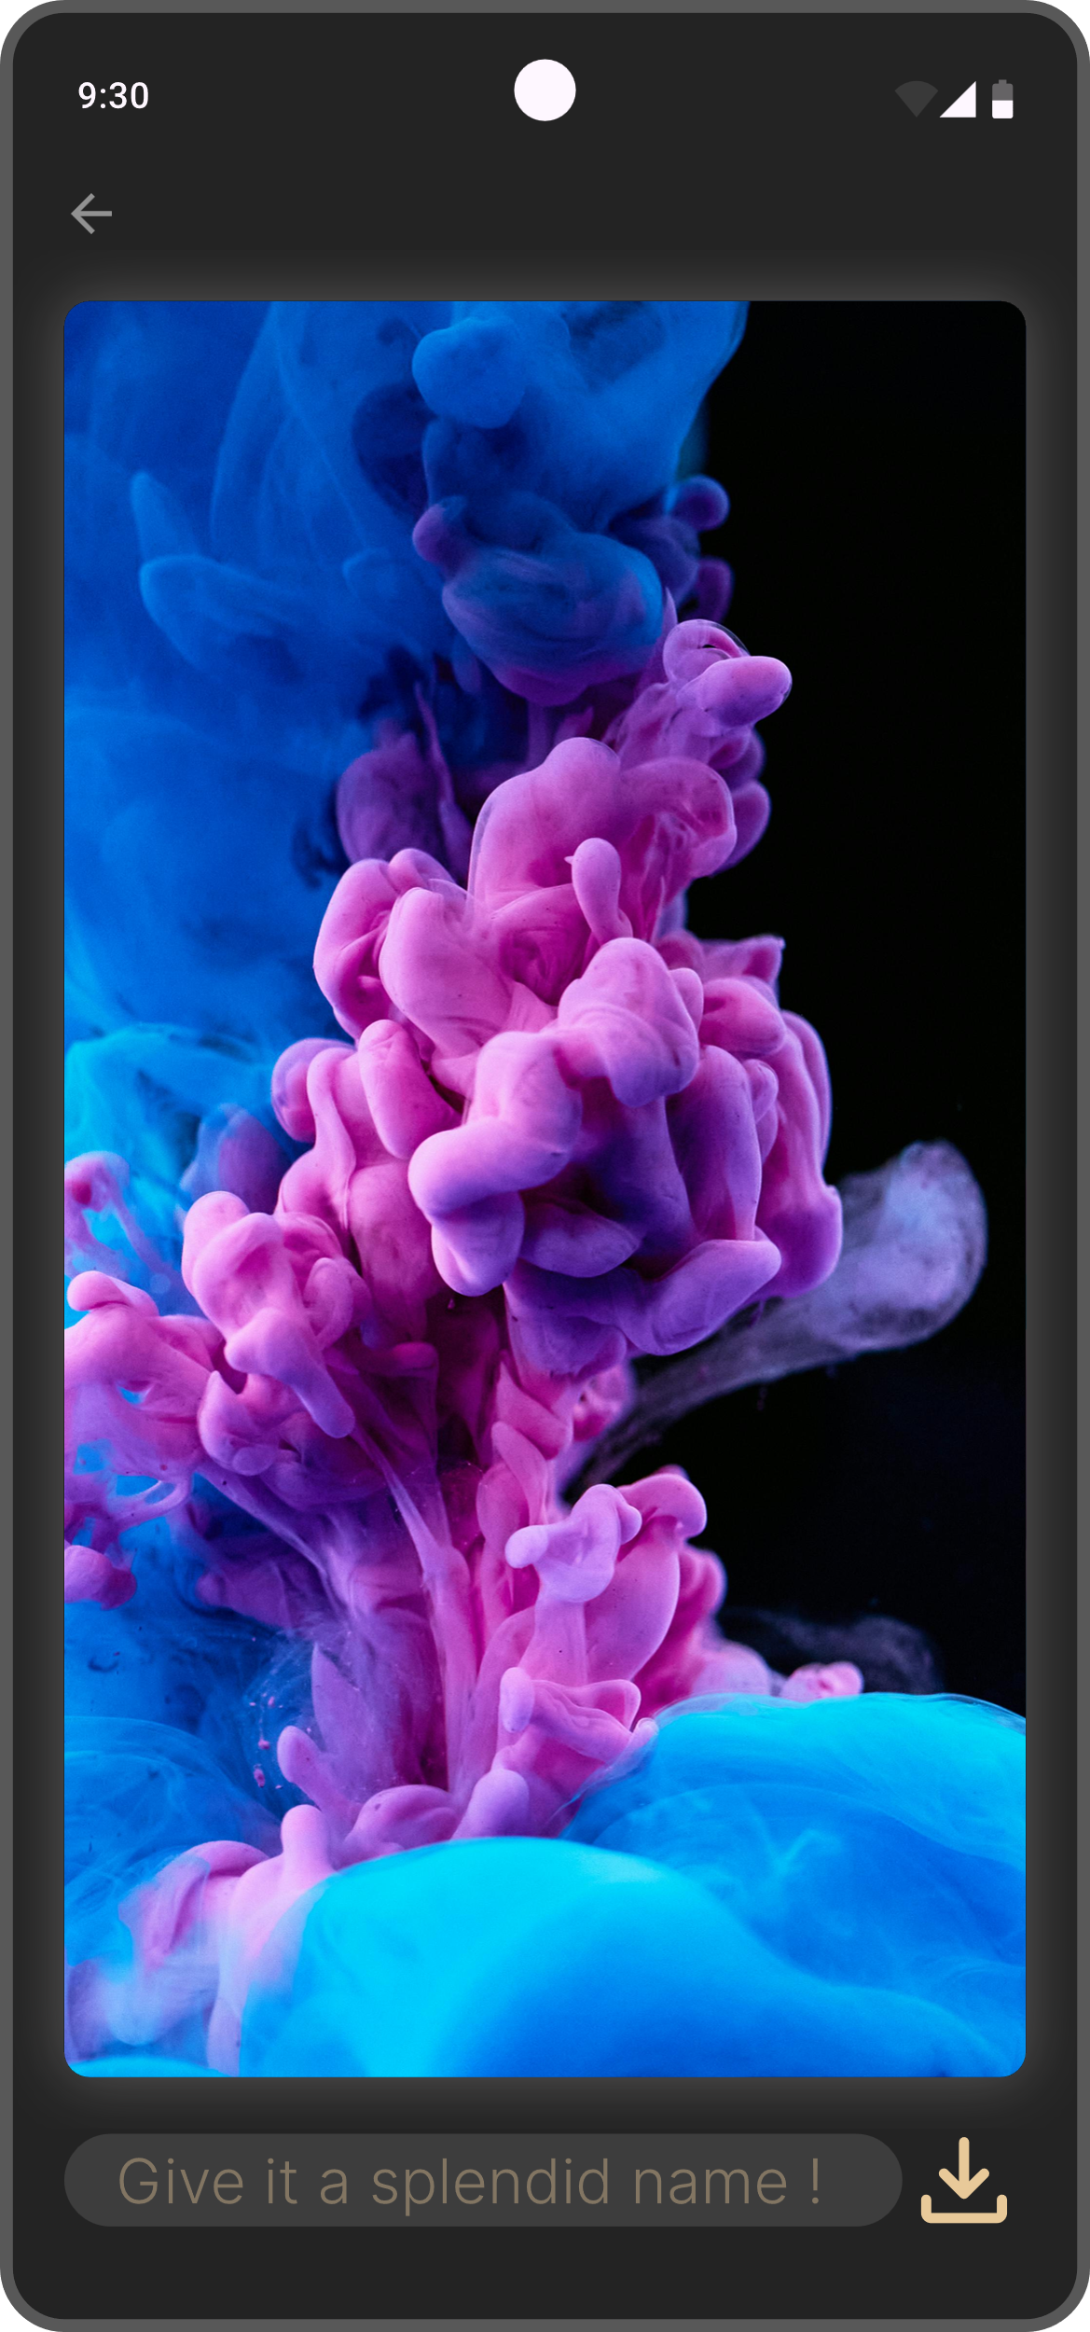
Feel The Impact
Track your message
Exchange government-subsided items /
vouchers with Sparks
CycHope
Hope Sharing

Slide 27







CycHope
CycHope
Automatically detects emotion
User manually input emotion everyday
Respond immediately
Book online consultations
Heartfelt messages from fellow caregivers
Online lectures on emotional wellbeing

Slide 28
A Place to express
Express Emotion, free from judgement
Vent Canvas
A Listening “Ear”

Slide 29
Keep the Emotion
Not the negativity
Your word will leave a mark
Vent Canvas
A Listening “Ear”

Slide 30


VentCanvas
VentCanvas
Illustrate Emotion from Voice
Detects tone and words
illustrate emotion from photos. Ordinary photos hard to encapsulate emotions of events
ArtMyMood
Generate Art From emotion
Talk to AI Chatbot
VentNow

Slide 31
Designated Groupings
There’s always a place for you
Caregivers in Singapore
Taking care of father with dementia
Currently working
Smart Grouping
Tailored support groups

Slide 32
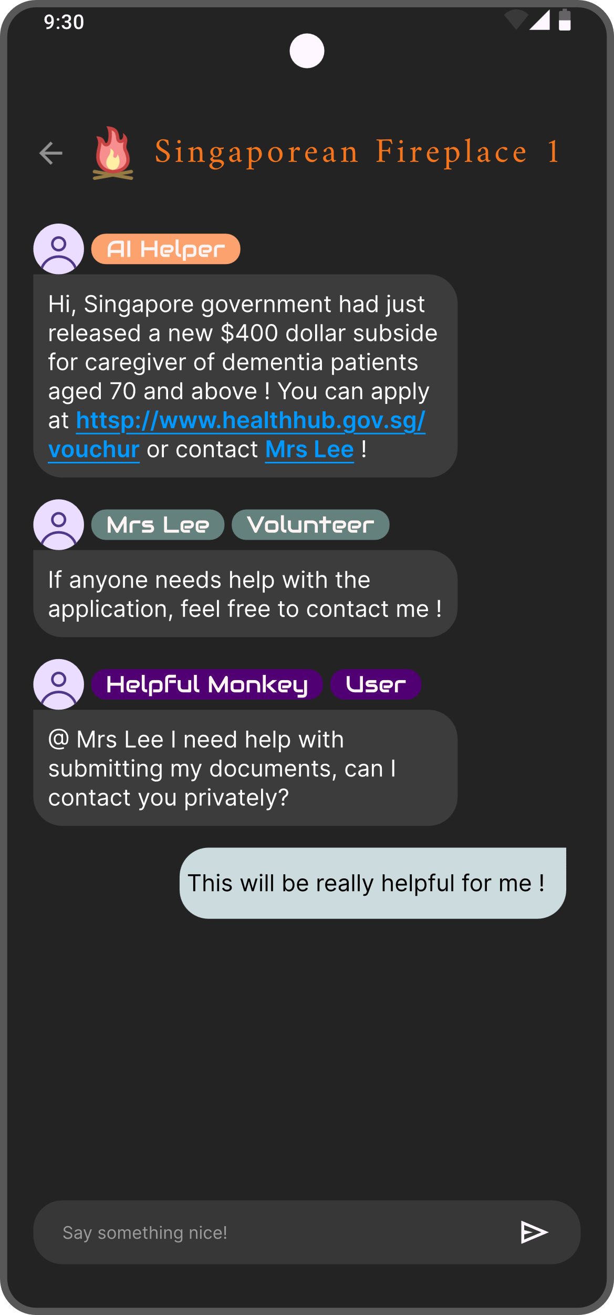

Ex-Users
Volunteers
AI Chatbot
Volunteer / Experts
Response when chat is not active
Direct access to professionals, helps & resources
Learn from past users to help future batches
Other Users
Anonymous, safe to express.
“Insiders” that gets their emotions
Disseminate targeted information for govt. and NGO
Smart Grouping
Tailored support groups

Slide 33
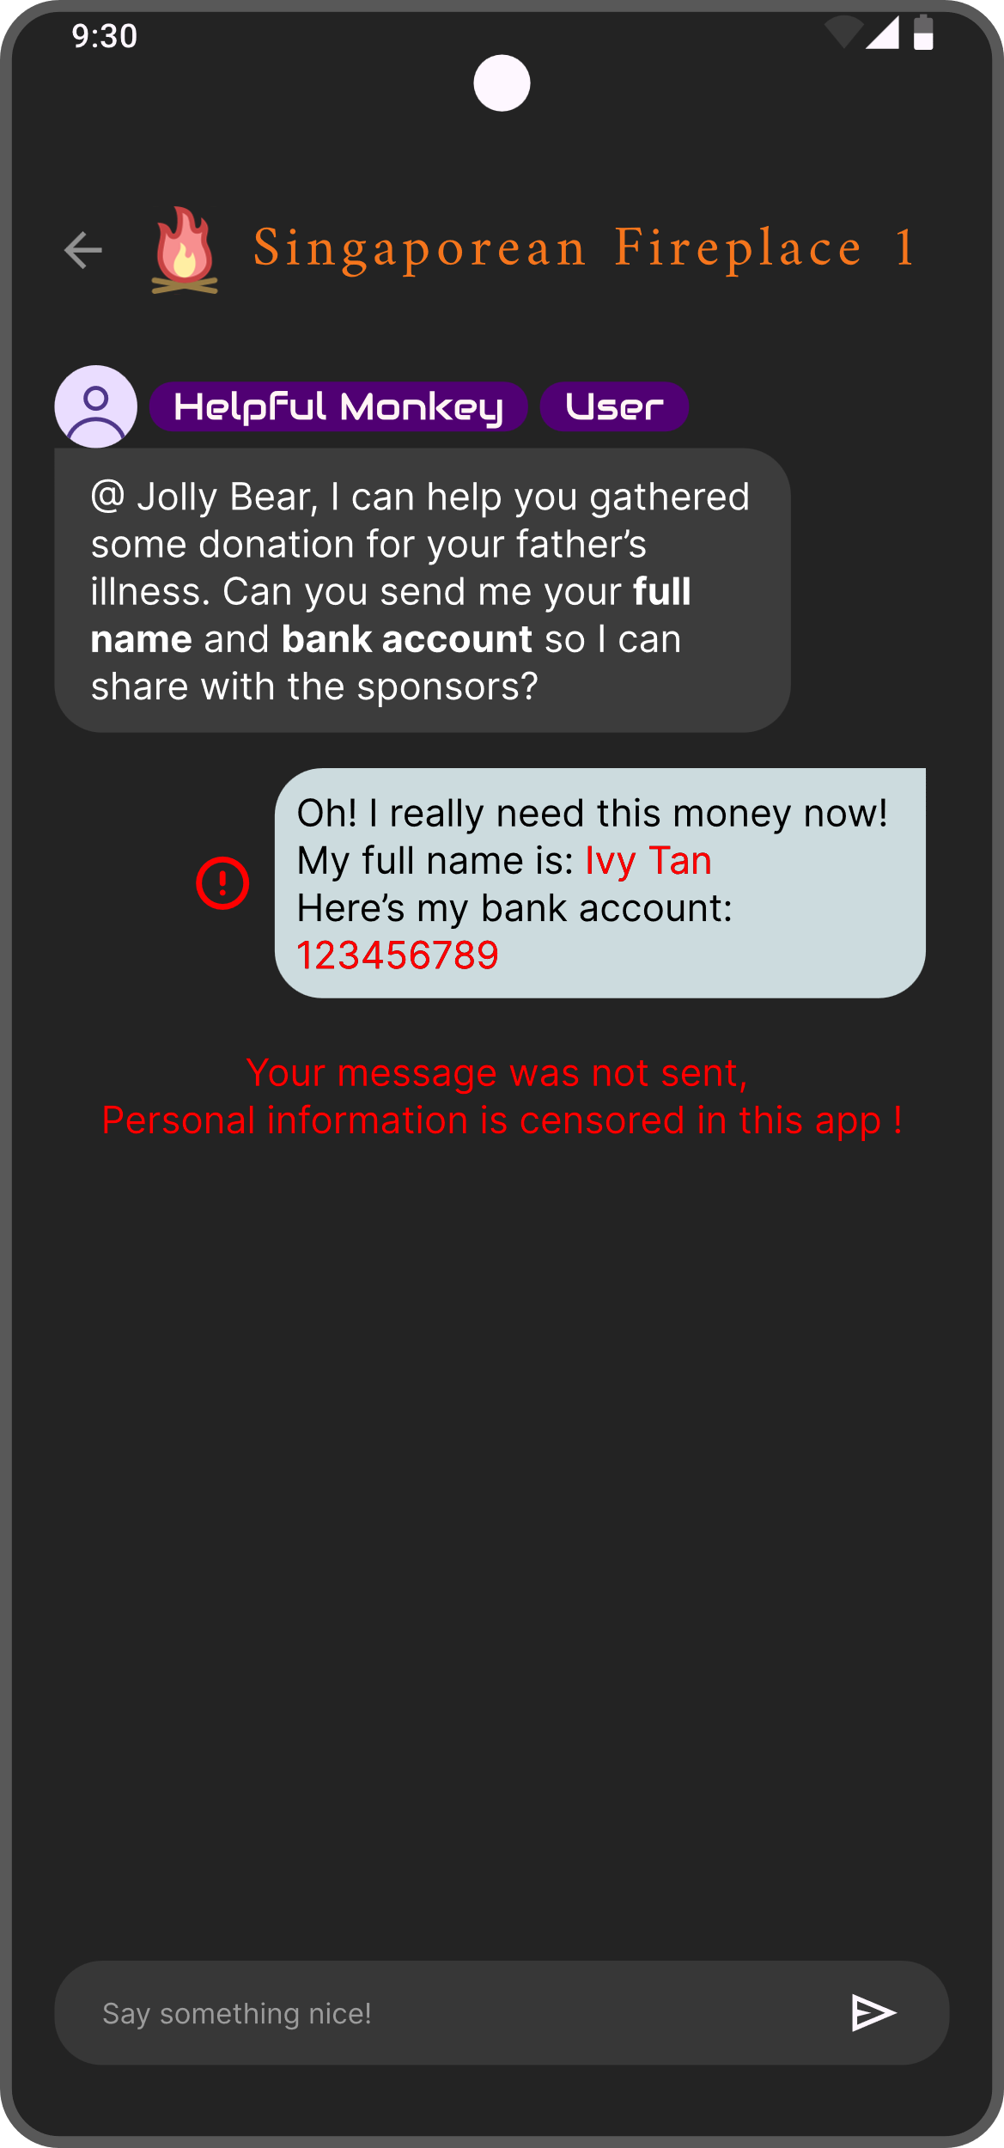
Chat Filtering
Filter out personal information
Provide a anonymous, safe space for caregivers.
Smart Grouping
Tailored support groups

Slide 34

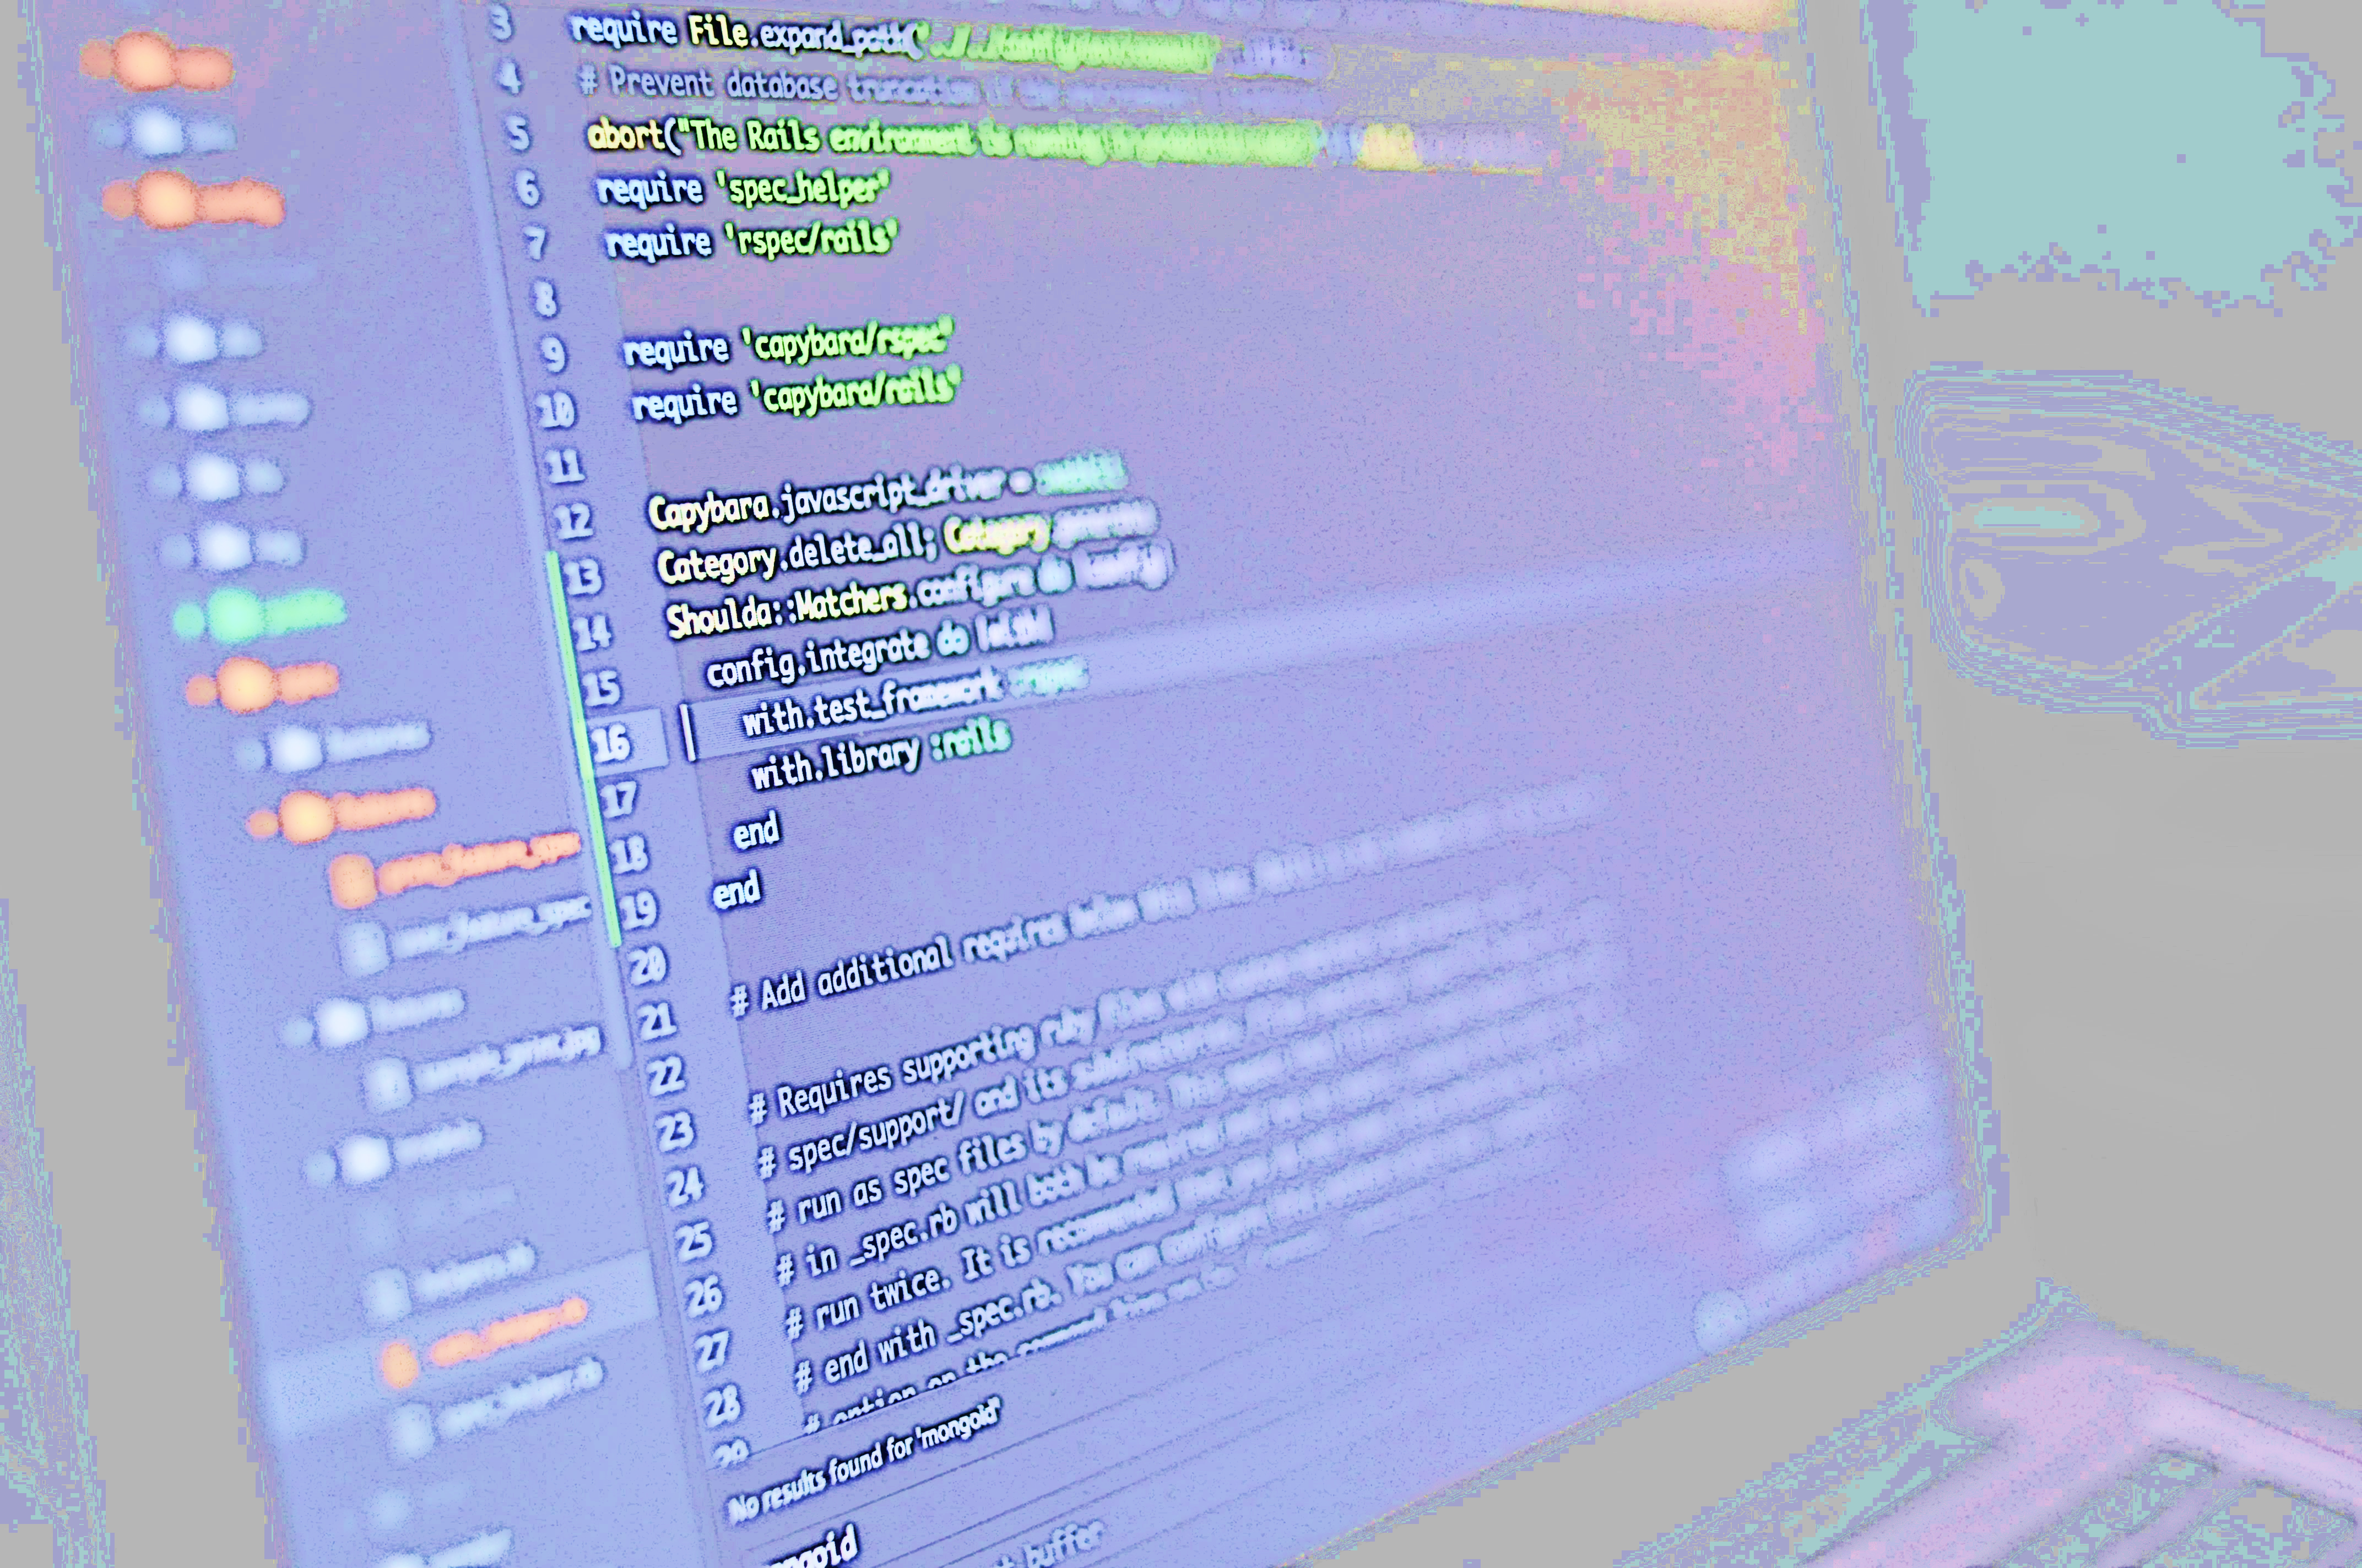

Slide 35




Message Storage
Dashboard Analysis
Early Stage
Later Stage
CycHope
Hope Sharing
Notes:
Post gres SQL

Slide 36
Emotional Inference Framework
More Access for higher accuracy
Content, facial expression, voice etc.
Non-intrusive & inconspicuous monitoring
e.g. only monitor time, duration, frequency, of opening app.
not content
Send “Surprise” messages
Disruptive
CycHope
Hope Sharing
Notes:
Post gres SQL

Slide 37
Mood
Inference Overview of current solution frameworks from various research agencies

Slide 38




90%
Facial-base
Distance between facial features
Basic emotion detection accuracy using artificial intelligence approaches in facial emotions recognition system: A systematic review, Hsu et al. 2025
Mood
Inference Overview of current solution frameworks from various research agencies
63%
Speech-based
Intensity, pitch, rate of spoken words
S. Bhatlawande, V. Telgote, S. Agrawal and S. Shilaskar, "Decoding Emotions from Sound: A Comprehensive Approach to Audio Emotion Recognition," 2024 International Conference on Cognitive Robotics and Intelligent Systems (ICC - ROBINS), Coimbatore, India, 2024
87%
Phone usage-based
apps duration, screen traces
Hung GC, Yang PC, Chang CC, Chiang JH, Chen YY. Predicting Negative Emotions Based on Mobile Phone Usage Patterns: An Exploratory Study. JMIR Res Protoc. 2016 Aug 10;5(3):e160. doi: 10.2196/resprot.5551. PMID: 27511748; PMCID: PMC4997004.
83%
Internet usage-based
Content viewed / posted
Outlined in:
Your Smartphone Knows you Better than you May Think: Emotional Assessment ‘on the Go’ Via TapSense
Detecting Users’ Emotional States during Passive Social Media Use
CHRISTOPH GEBHARDT∗, ANDREAS BROMBACH∗, TIFFANY LUONG, OTMAR HILLIGES, and CHRISTIAN HOLZ,Departmentof Computer Science, ETH Zürich, Switzerland

Slide 39
Notable Architectures
Clustering
Usage Patterns Classification
Transformers
Temporal Information (Audio)
Mixed
Architectures
Convolutional neural network
Spatial information (Image)

Slide 40
Inconspicuous & Novel Methods
Weather & GPS
Gyroscope, accelerometer
Typing speed, touch pressure, error rate from touch interactions
Eye Tracking

Slide 41

Reinforcement
Learning
Explicit User Response
Implicit User Response
User provide personal info directly
If user’s subsequent actions is against prediction
When unsure of prediction
Punish AI
Prompt user to confirm prediction

Slide 42
Reinforcement Learning
Unlabelled Raw Data

Slide 43
Reinforcement Learning
Identify Clusters
e.g. K-mean

Slide 44
Reinforcement Learning
Associate clusters with traits
Happy
Angry

Slide 45


Open Source Transformer Library of Pre-trained models
Wave 2 Vec
Allow machine to understand context of speech
Emotional Classifier
Understand context
Front-End Illustrations
HTML CSS JS
Vent Canvas
A Listening “Ear”

Slide 46
Live Demo
Vent Canvas
A Listening “Ear”

Slide 47

Classification
Directly ask for Information
If information is not provided, VentCanva & CycHope is still available.
Train AI Chatbot with past user interactions
For more accurate & humanized support for future users
Low Rank adapter to learn from user data
Context-Aware
Smart Grouping
Tailored support groups

Slide 48





Privacy Framework Our Top Concern

Slide 49

Transparency & Consent
Transparency
Inform user on how will the data be used
Granular Consent Users can choose level of privacy, i.e. inference methods
Data Retention Limit
Deleted every 30 days

Slide 50

Filtering Infomation
Anonymization
Irreversibly remove IDs like names
Pseudonymization
Replace IDs with tokens

Slide 51
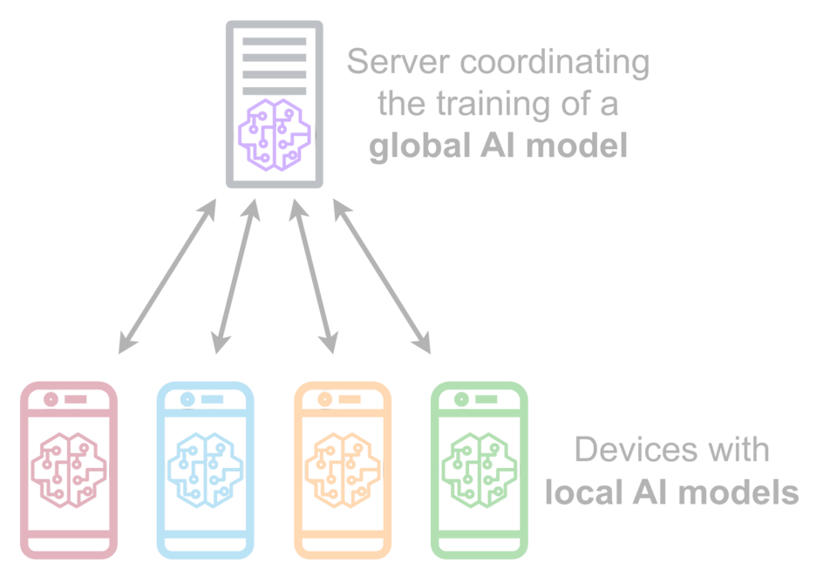

Federated Learning Train models on directly devices
Source: Wikipedia
Share only anonymized model updates Not raw data.
Partially reduce training cost

Slide 52

Technological Protection
End-To-End Encryption
Only Sender & Receiver can read information
Zero-Knowledge Servers
Servers only store encrypted data, with users holding the decryption keys.

Slide 53



Slide 54


Government & NGO Grant
CycHope compliments other solutions,
Making them more efficient

Slide 55
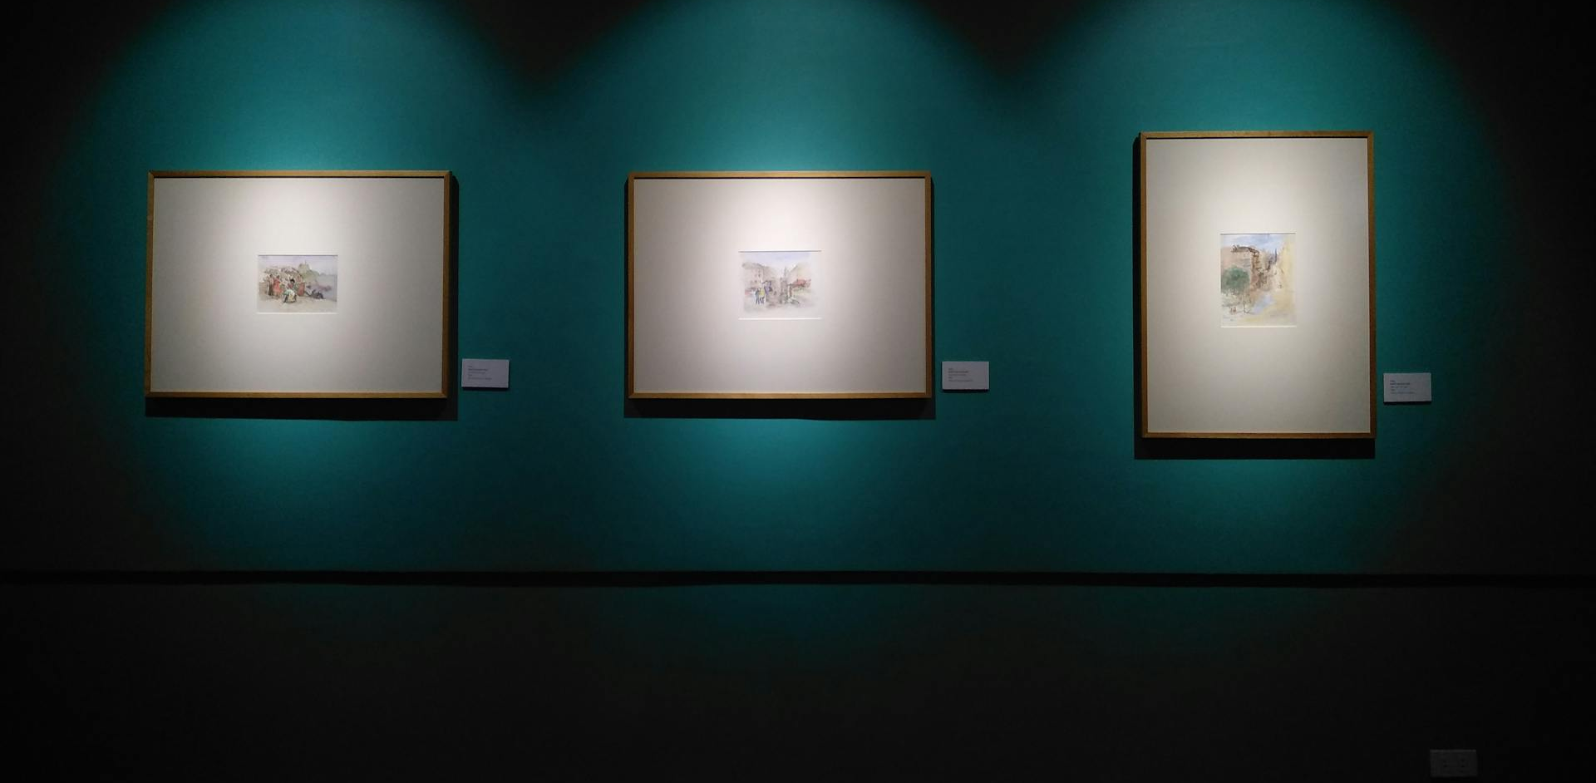
App Development
Hosting
AI Model
Marketplace of VentCanvas
Emotions to Art, Art to Value
Users can turn VentCanvas art into NFTs
Revenue will be given back to community
Cost Structure

Slide 56

App Development
Hosting
AI Model
Cost Structure

Slide 57
Hosting
AI Model
App Development
Serverless Hosting to reduce cost
Use open source & pre-trained model
B2B Services
e.g. VentCanvas
Cost Structure

Slide 58
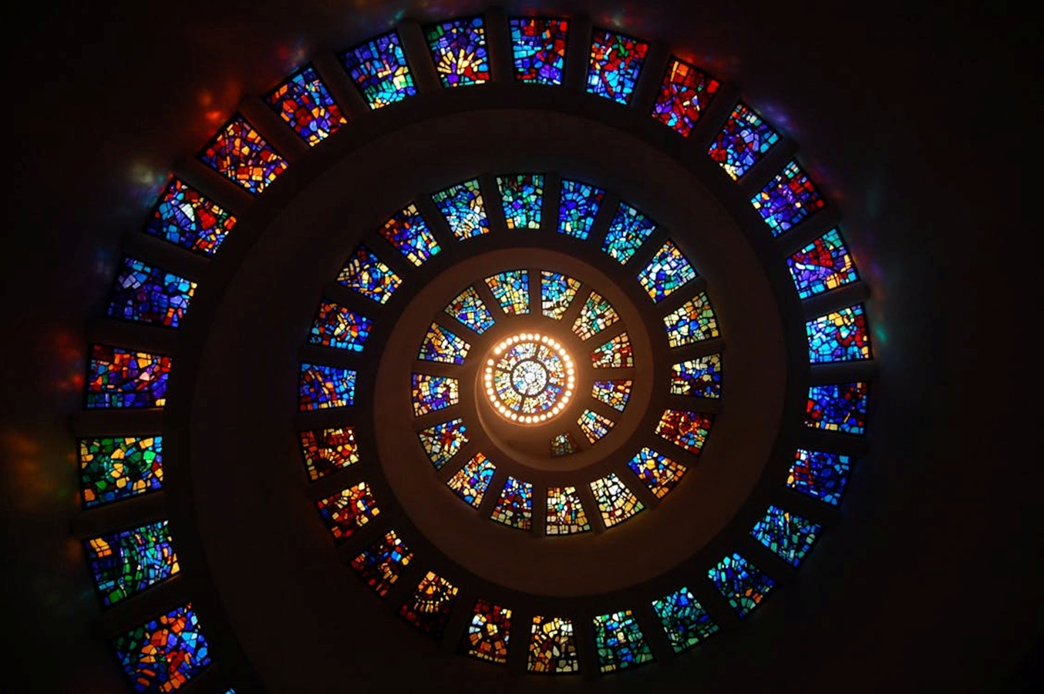

Stress Reduction
Depth of Usage
Active Users

Slide 59
Active Users
Stress Reduction
Depth of Usage
Measure X Day Retention
Conduct Survey Amongst Users
Track statistic of each feature

Slide 60

CycHope
Support that finds you

Slide 61
Citations
Big Numbers
*Caregiving in the U.S. 2020 - AARP Research Report
Global estimates of informal care - Alzheimer’s Disease International and Karolinska Institutet
Chakraborty, R., Jana, A., & Vibhute, V. M. (2023). Caregiving: a risk factor of poor health and depression among informal caregivers in India- A comparative analysis. BMC Public Health, 23(1). https://doi.org/10.1186/s12889-022-14880-5
‌Singapore Hospice Council. (2024, September 12). Singapore Hospice Council. https://www.singaporehospice.org.sg/caregiver-burnout-understanding-managing-and-preventing/
Articles
‌“I worry if he’s taken care of”: The tears and fears of millennial caregivers to siblings with special needs. (2021). CNA. https://www.channelnewsasia.com/singapore/millennial-caregivers-siblings-special-needs-4900466
Williams, B. (2025, March 4). Unpaid carers: “I love my dad to bits - but I reached breaking point.” https://www.bbc.com/news/articles/c15qn2kv3qno

Slide 62
Citations
‌Pictures in slides
(2025). Seniorslifestylemag.com. https://seniorslifestylemag.com/wp-content/uploads/2017/03/bigstock-Hospital-Nurse-With-Digital-Ta-114155408-scaled.jpg
‌MART PRODUCTION. (2021, March 25). A Person Standing on the Subway Platform with a Train Passing · Free Stock Photo. Pexels. https://www.pexels.com/photo/a-person-standing-on-the-subway-platform-with-a-train-passing-7252768/
gomes, luis. (2017, August 8). 黑色和灰色筆記本電腦 · 免費圖庫相片. Pexels. https://www.pexels.com/zh-tw/photo/546819/
olia danilevich. (2020, October 18). flatlay, 一百美元的鈔票, 儲蓄, 利潤, 商業金融, 帳單安排, 平躺, 投資, 收入, 收益, 會計, 現金, 現金周轉, 盈利能力, 紙幣, 經濟, 經濟價值, 經濟概念, 經濟穩定, 繁榮, 美元, 美元紙幣, 背景, 豐富, 豪華, 財務上的成功, 財務增長, 財務安全, 財富, 財富累積, 貨幣, 金融, 金融主題, 金融背景, 金融計劃, 金錢模式, 金錢管理, 鈔票, 鈔票收集, 銀行業, 錢, 錢壁紙, 錢背景, 預算, 首都 的免費圖庫相片. Pexels. https://www.pexels.com/zh-tw/photo/5466796/
Sora Shimazaki. (2020, October 26). 正式女企業家討論城市管理的文件 · 免費圖庫相片. Pexels. https://www.pexels.com/zh-tw/photo/5668430/
Atlas, P. (2018, December 12). 三幅掛在畫廊的畫 · 免費圖庫相片. Pexels. https://www.pexels.com/zh-tw/photo/1674049/
‌Pictures and icons in figma
cottonbro studio. (2021, September 26). High-Speed Photography of Colorful Ink Diffusion in Water · Free Stock Photo. Pexels. https://www.pexels.com/photo/high-speed-photography-of-colorful-ink-diffusion-in-water-9669089/
Google. (n.d.). Google Fonts. Google Fonts. https://fonts.google.com/icons
Infinite AI-Artboard. (n.d.). Recraft. https://www.recraft.ai/

Slide 63
Citations
AI usage
[DeepSeek & Monica was used in the process of research. However, these AIs do not allow exportation of chat history]
‌
Chat GPT: https://chatgpt.com/share/67f14544-ebb0-8006-bd31-f59cc8408cf9

